Slide 1
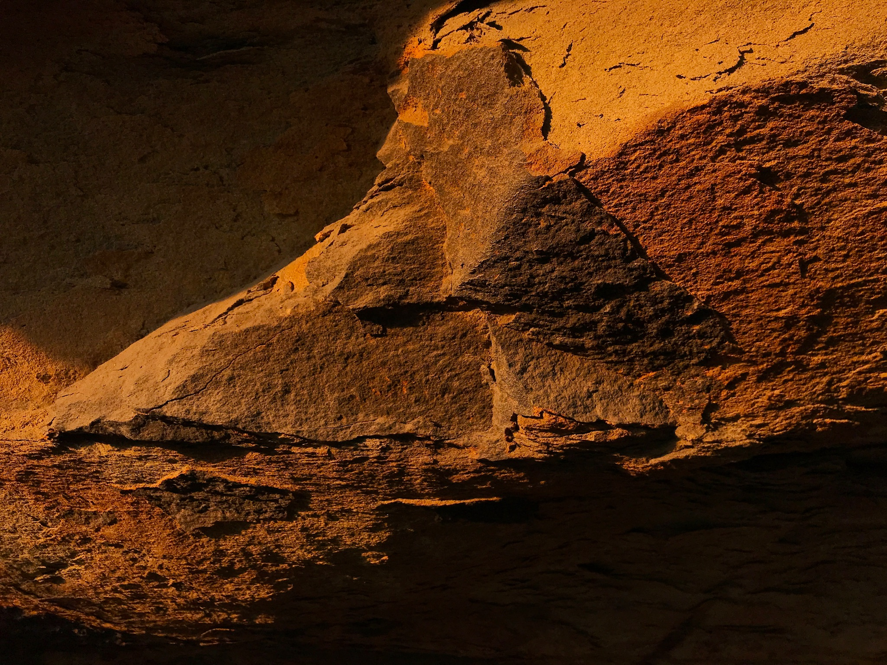
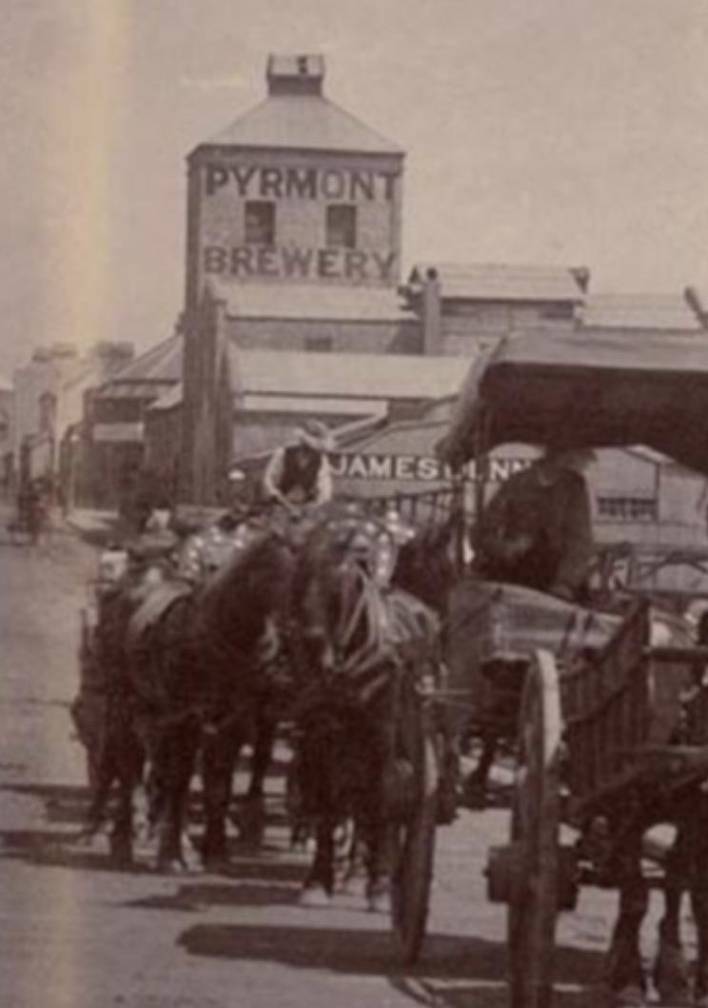
Brewing in Pyrmont and Eora country
Prepared for The Pyrmont History Group,February 2020 Kev Staunton-Lambert pyrmontbrewery.com

Slide 2
Brief history of Pyrmont beer swilling (why we brew!)
Beer drinking in the pub has been central to working class Pyrmont in the truest sense of the word ‘Public House’ since its earliest days - our national identity/culture - dinky di
Pyrmont pubs were shared spaces on literally every street corner amongst small terraces
(there used to be 26 of them!)

Slide 3
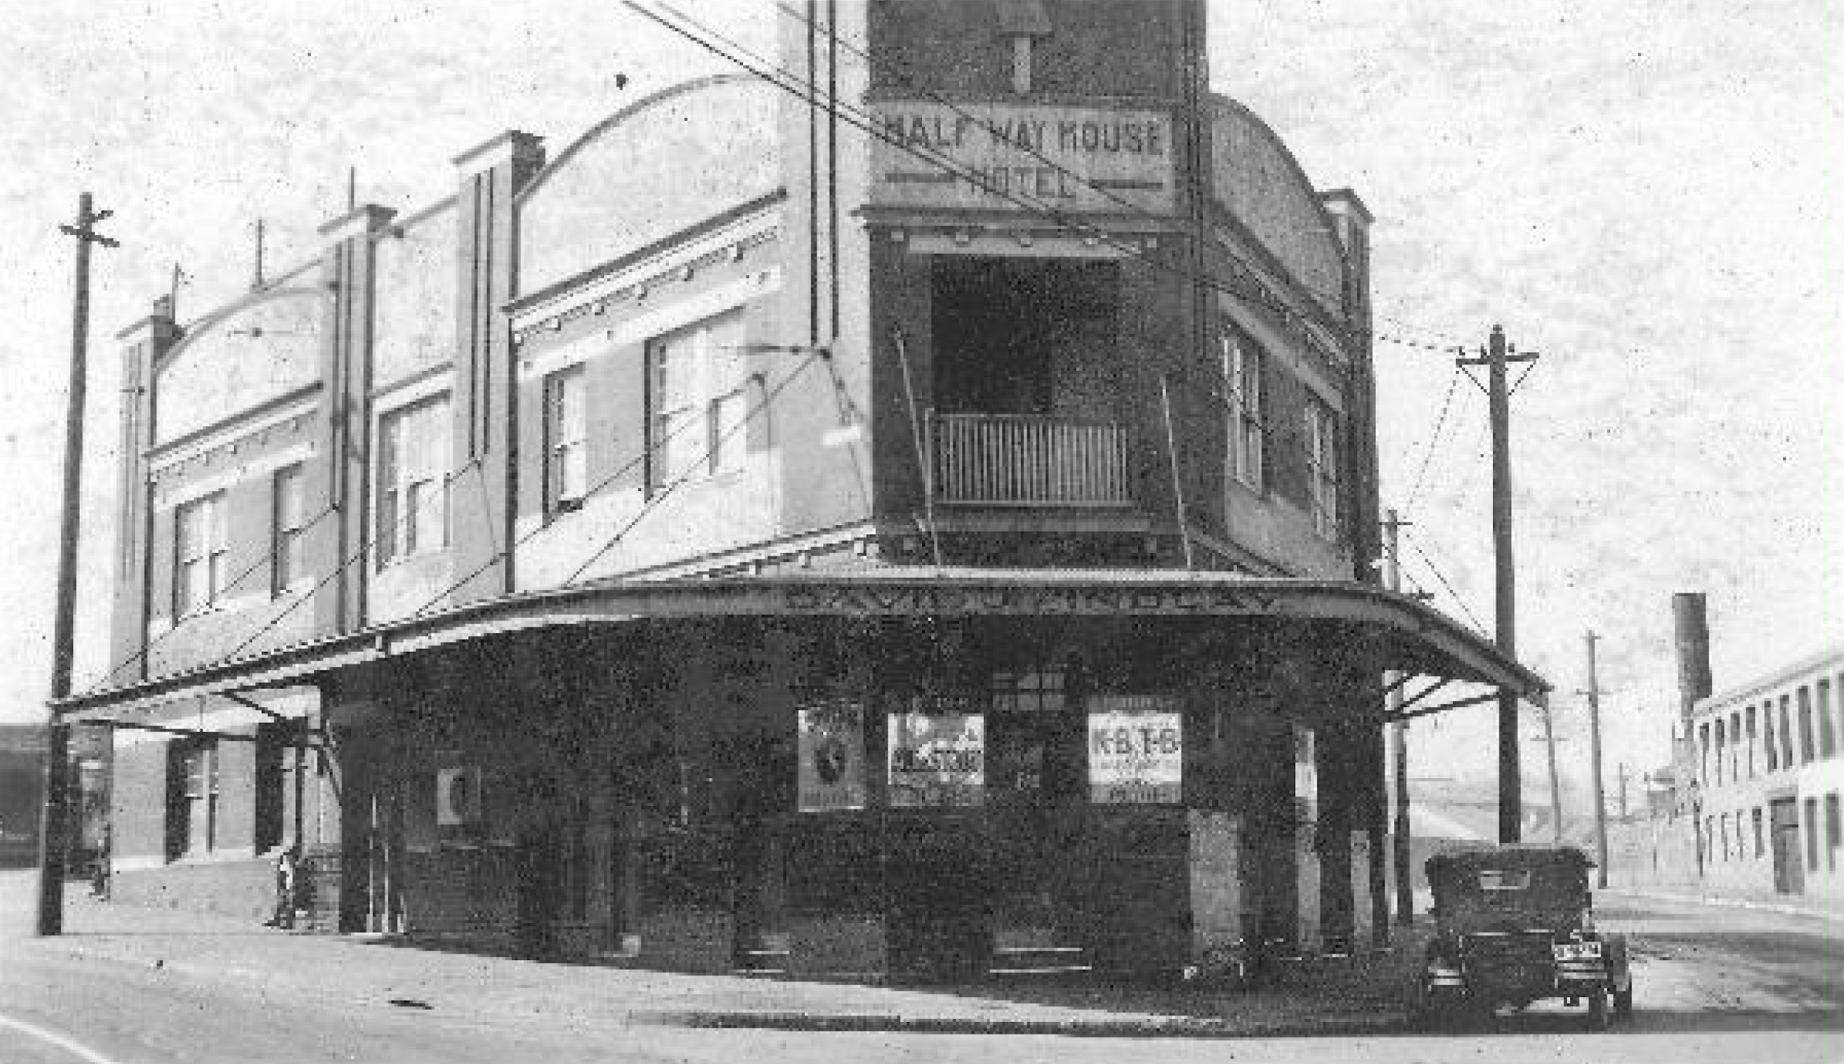
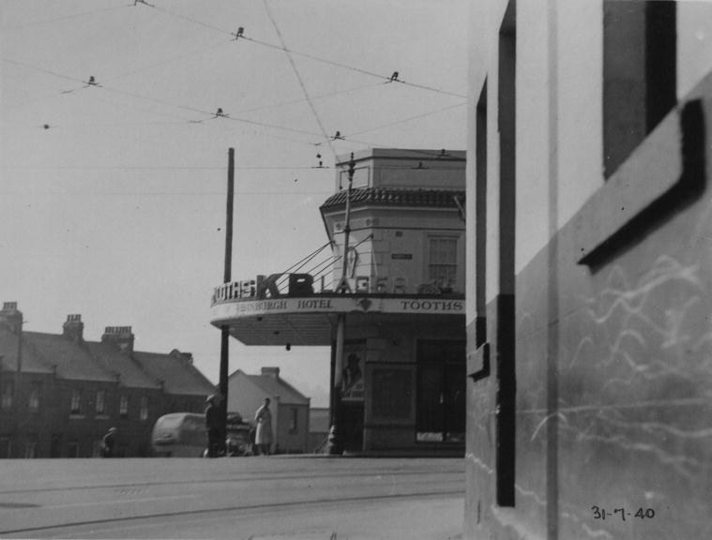
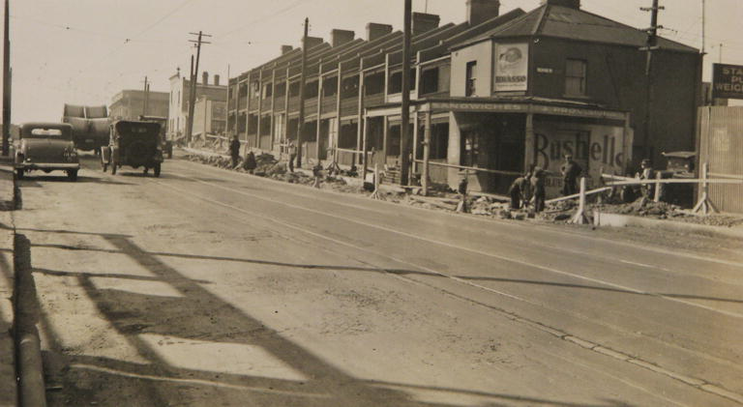
Small Pyrmont private houses sharing a public house
Harlequin and Half Way House and Dunkirk/Quarrymans/Terminus/Point + Bridge, New York are all very close to brewery!
Half Way House Hotel
Harlequin
(Duke of Edinburgh)
My little Nano Brewery on Miller Street

Slide 4
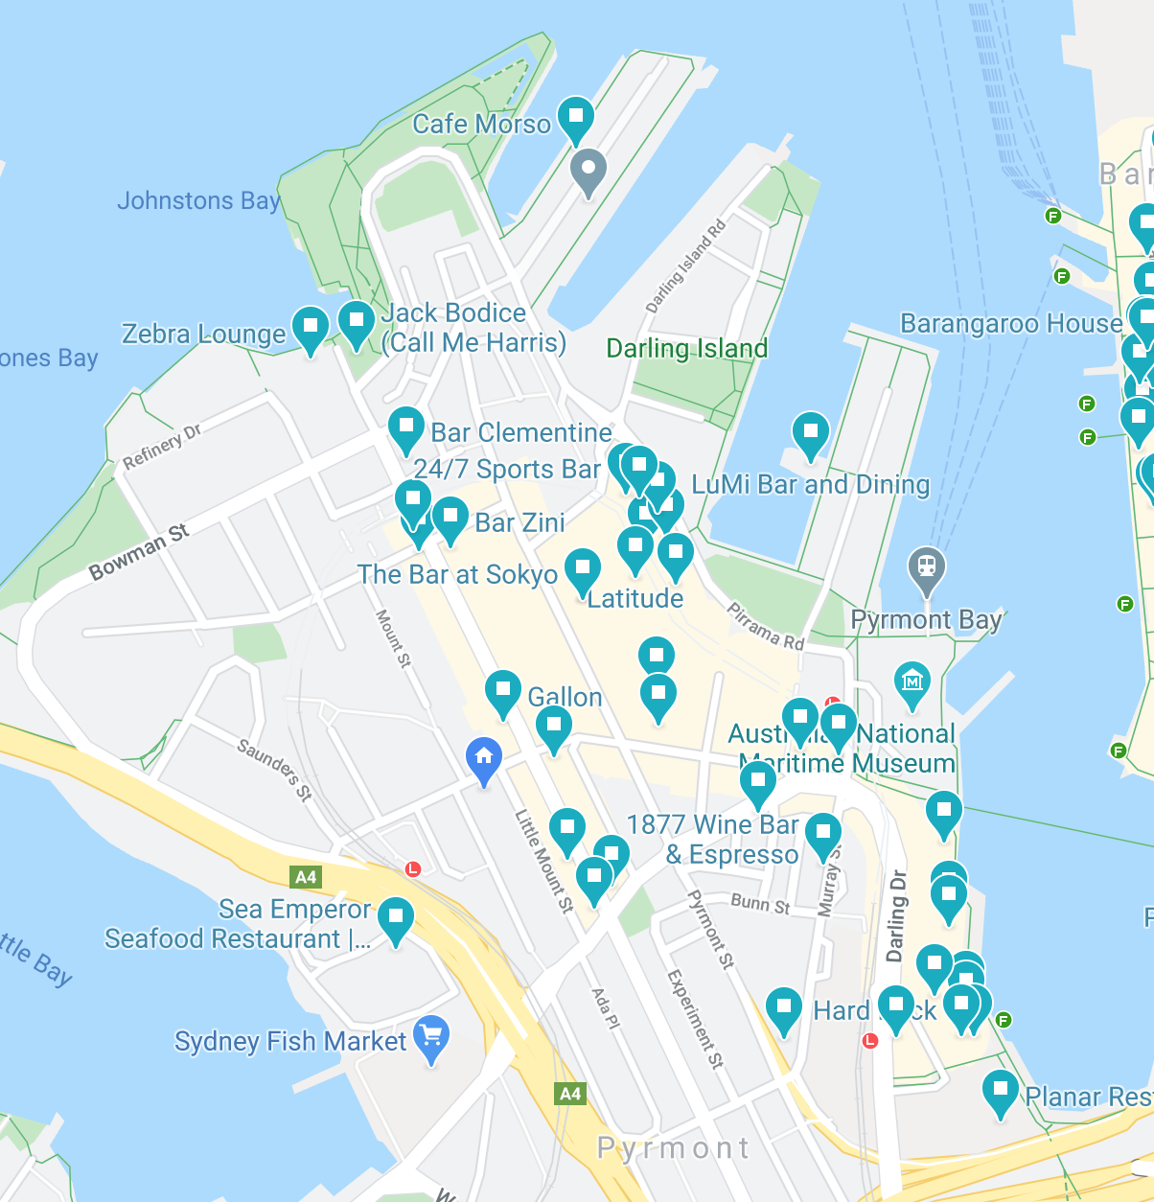
Today still heaps
of
local
Pubs
And
bars!

Slide 5
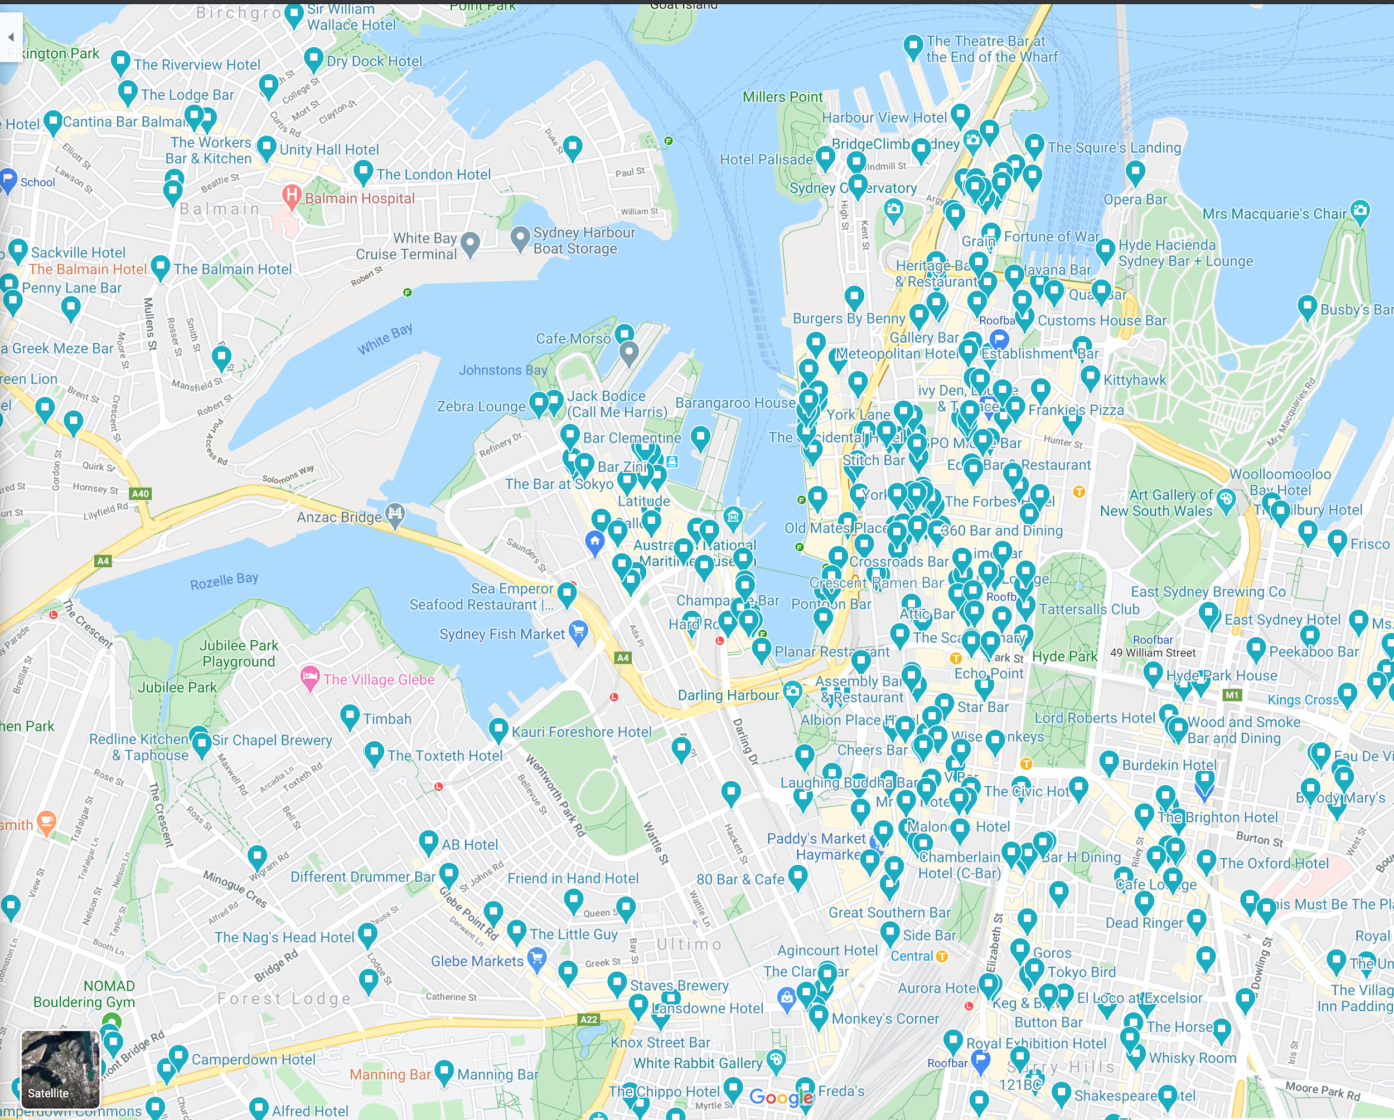
And
plenty
more
nearby

Slide 6
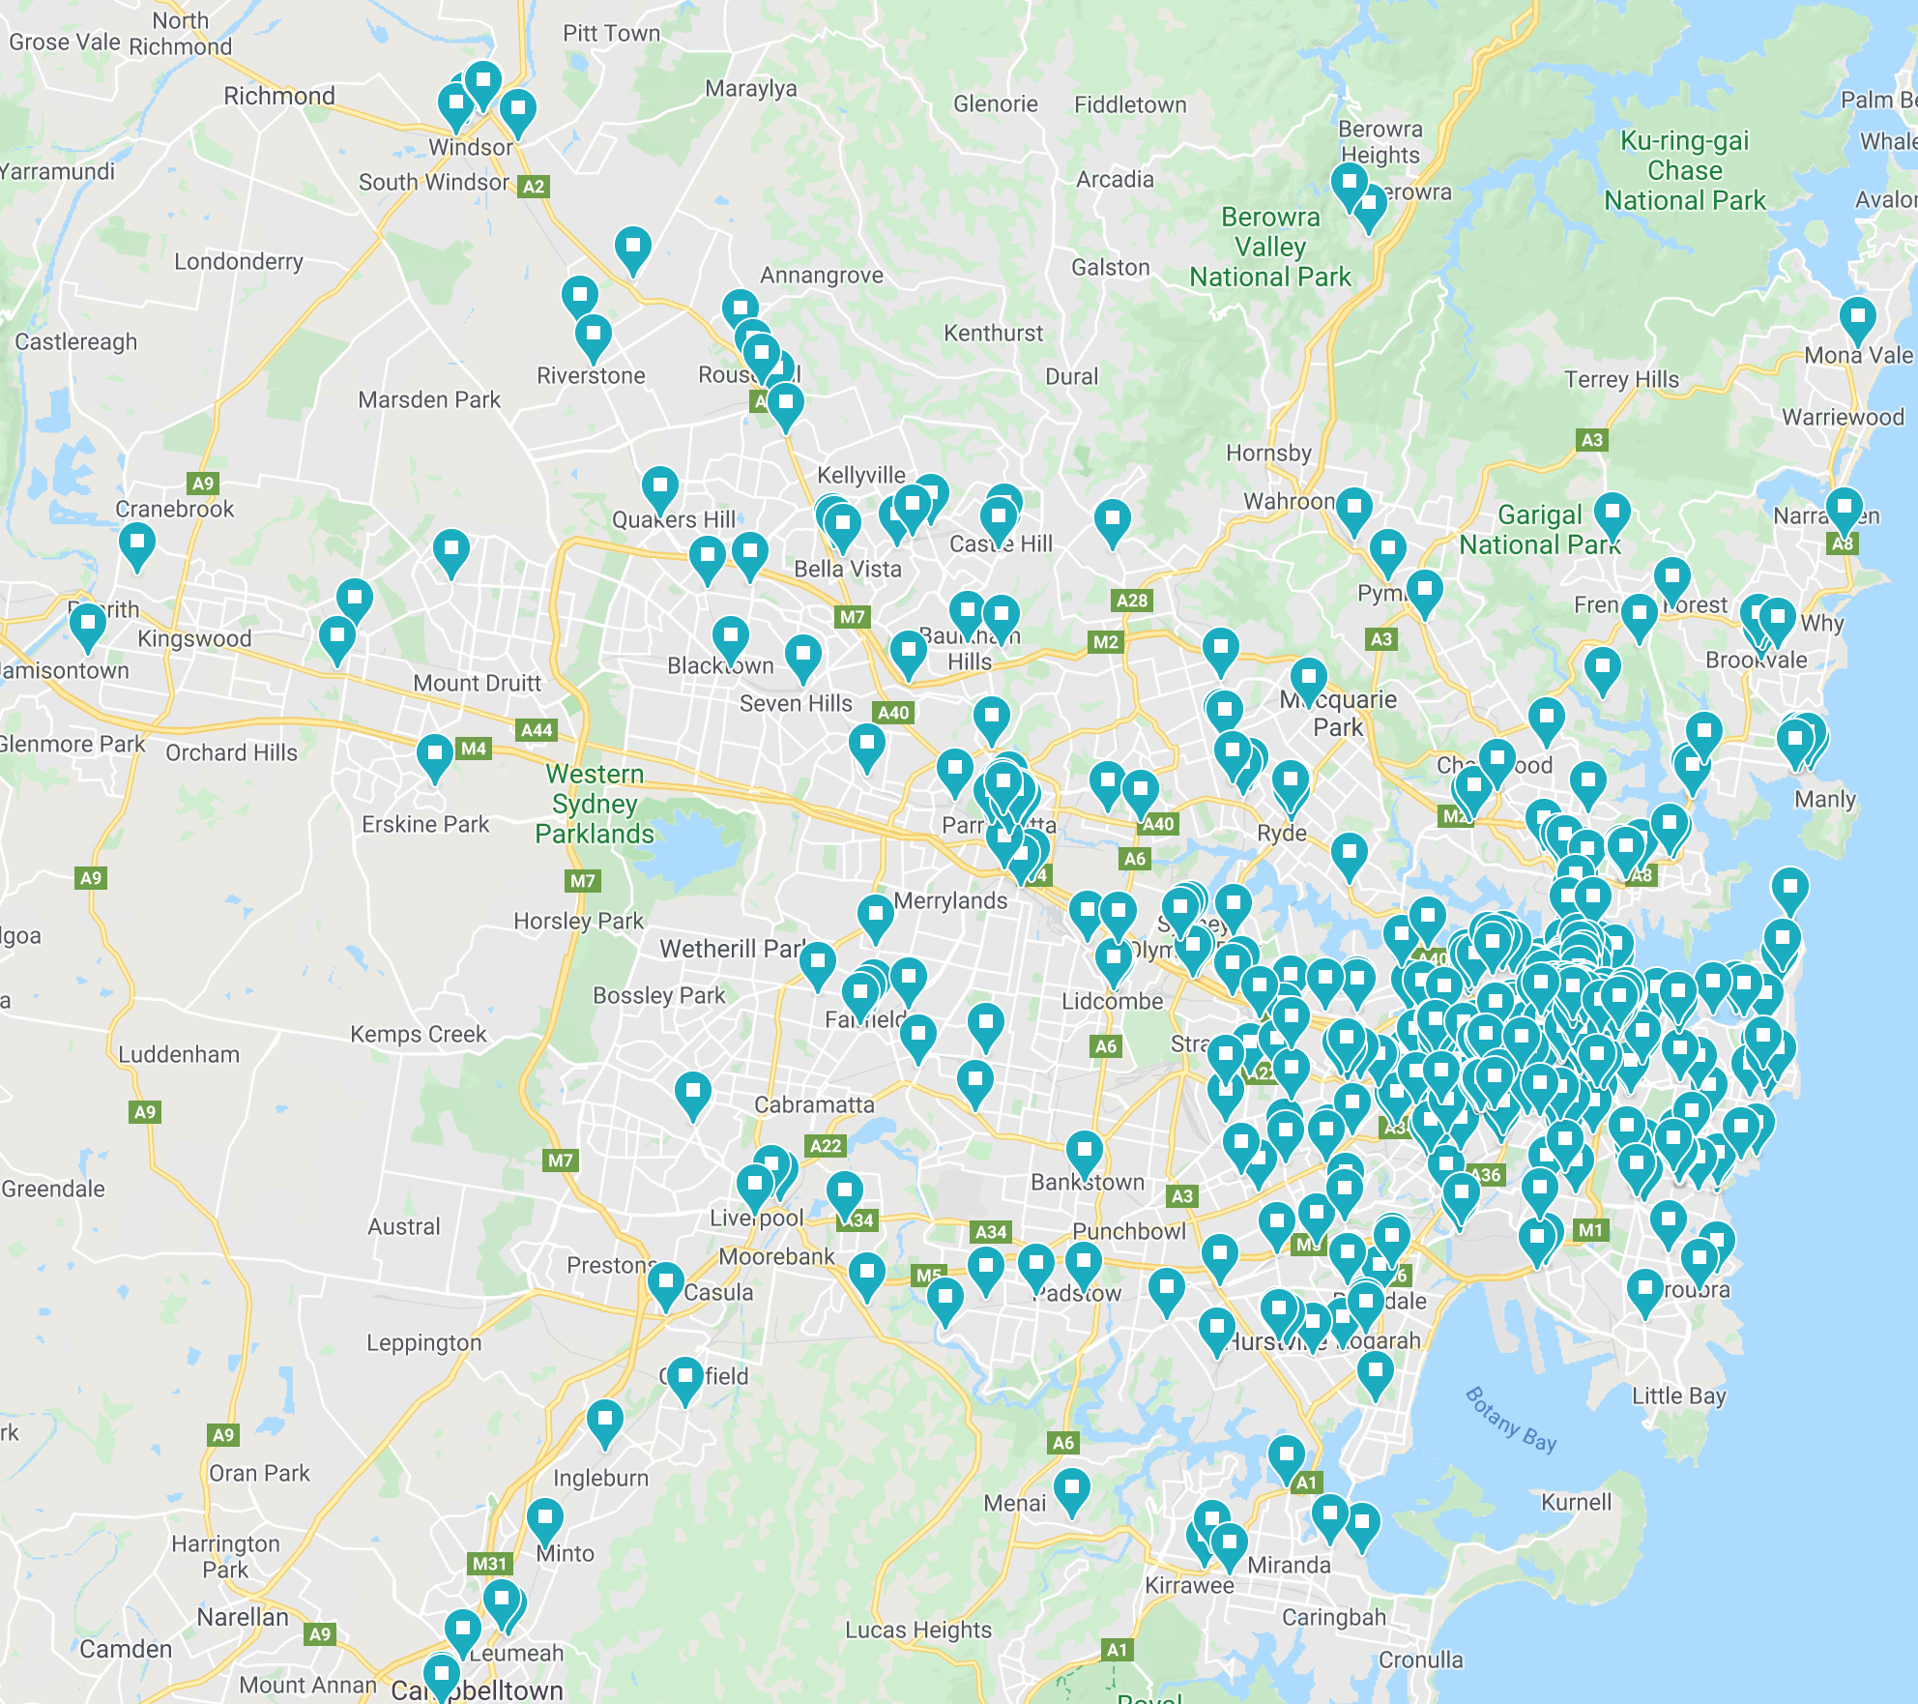
Seriously
Heaps!

Slide 7
What may have been the first beer sold in Pyrmont
James Squire was the first to brew ales* near Meadowbank 1796 (8½ miles Pyrmont by boat)
Squire started with (bitter tasting) horehound but later was first to grow hops at Kissing Point Farm
* John Boston may have beaten James to first commercial ‘beer’ sale, but that was corn based ‘beer’ bittered with a gruit of apple stalks and gooseberry leaves, quite different to using barley and hops beer! But applause for making do

Slide 8
Beer takes off! - Hobart’s more Beer less Rum! 1802
“The introduction of beer into general use among the inhabitants would certainly lessen the consumption of spirituous liquors [rum]. I have therefore in conformity with your suggestion taken measures for furnishing the colony with a supply of ten tons of Porter, six bags of hops, and two complete sets of brewing materials.”, The HMS Porpoise brought those hops to Squire

Slide 9
Pyrmont Brewery in 1880 (Felmingham)
The Pyrmont History Group have on their website this fabulous photo of the earlier 1857-1902 Pyrmont Bridge clearly showing a ‘Pyrmont Brewery’ building >
This was where the PBH is today (Murray and Union Streets)
“the beer sent out being light, sound, and refreshingly bitter”.

Slide 10
Pyrmont Brewery in 1880 (Felmingham)
Sydney Morning Herald write up was “the beer sent out being light, sound, and refreshingly bitter. Every effort is made to assimilate this beer to the pale ale produced by Allsopp and Bass”
Samuel Allsopp and Bass is English beer
So same as today, the Pyrmont Brewery also brewed English ales back then too

Slide 11
But, eh oh... Beer Excise Tariff act 1901
Whilst introducing beer helped quash the rum rebellion, this act of parliament made Pyrmont Brewery unsustainable - well, and kind of illegal
17 local Sydney breweries - including two local Ultimo breweries were lost forever! 😢
[Transformations: Ecology of Pyrmont peninsula 1788 - 2008 cites Tooth and Co Brewery Sydney for this insight]

Slide 12
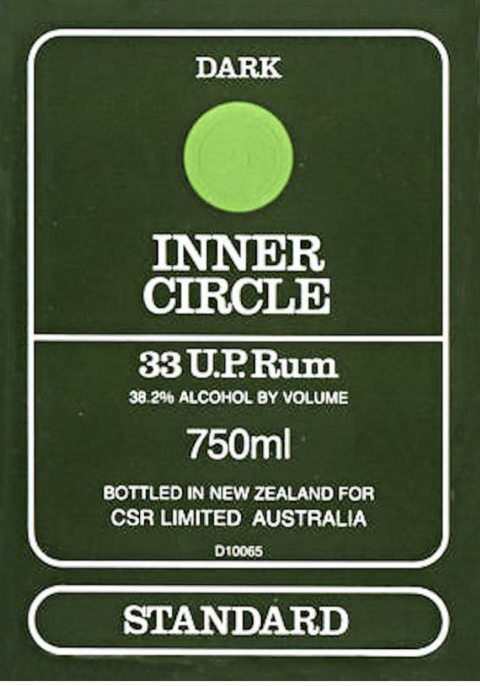
Other alcohol production in Pyrmont since 1900
The Colonial Sugar Refining Company (Jackson’s Landing) distilled ind. spirit methylated alcohol, also small batch ‘Inner Circle’ rum made from molasses coming from Fiji and Queensland
CSR rum became Bundaberg, ‘Inner Circle’ was still blended in Fiji ~ 2003
Not entirely sure how/why it was bottled in NZ though

Slide 13
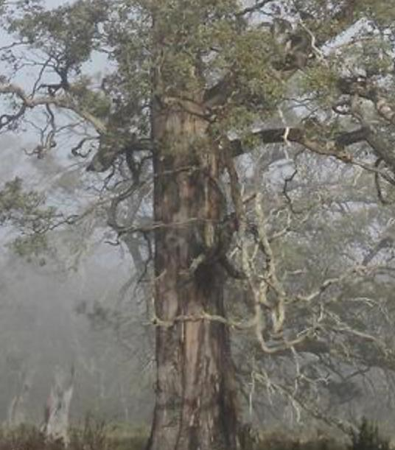
What about the traditional custodians of Pirrama?
There is evidence that Aboriginal people were well aware of fermentation processes to make beverages
But the Eucalyptus described in the process only grows cooler places. e.g. Tasmanian ‘Cider trees’ - it seems then less likely that alcohol was actually made in the local Pirrama / Gadigal territory before European settlement

Slide 14
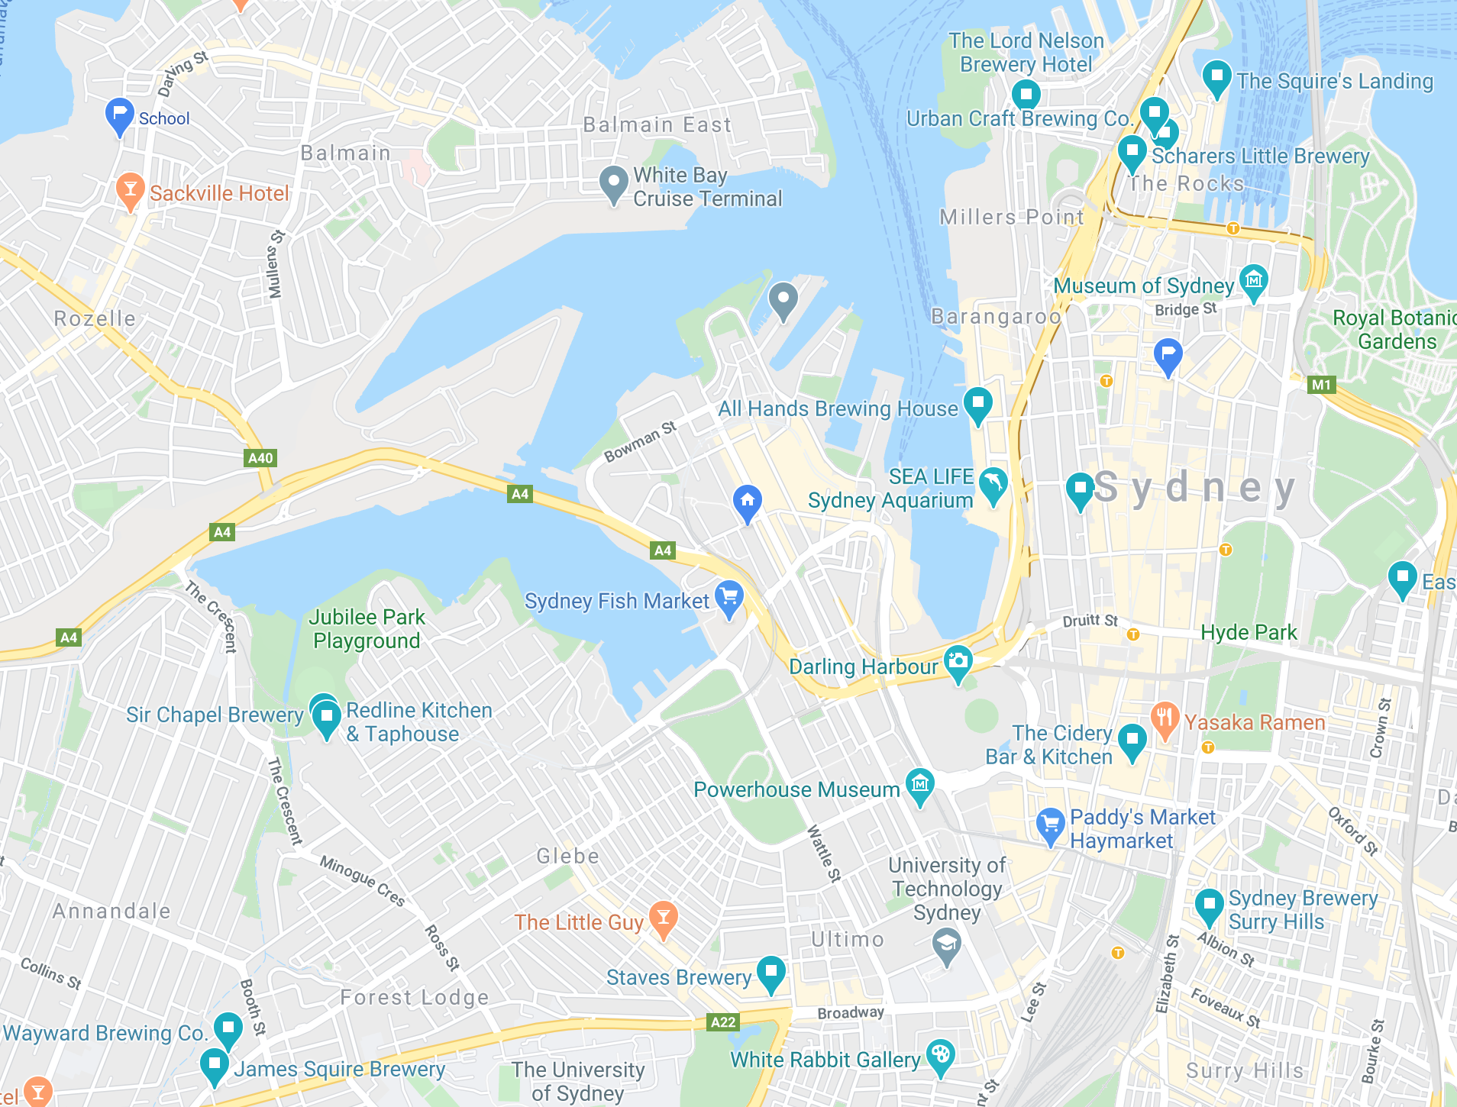
Modern beer brewing today in Gadigal territory
Obviously the Lord Nelson (Rocks) needs a honorary mention, on-site brewing since 1986
+ fair number of newer breweries in order of distance from Pyrmont… All Hands (Darling Harbour), Staves (Broadway), Redline (Tramsheds), Wayward and Malt Shovel (Camperdown), The Surry Hills and Redoak

Slide 15
Challenges of brewing in 1790s vs how it is today
#1 Finding fresh Grain (grow and malt some barley) #2 Mill and Mash it (convert starches to sugar) #3 Lauter (remove grain/sparge to get wort) #4 Boil wort with hops (kill enzymes, hops add flavour) #5 Ferment with yeast (= ethanol alcohol + CO₂) #6 Store for a bit without drinking it
Modern beer just the same but a little more tech!

Slide 16
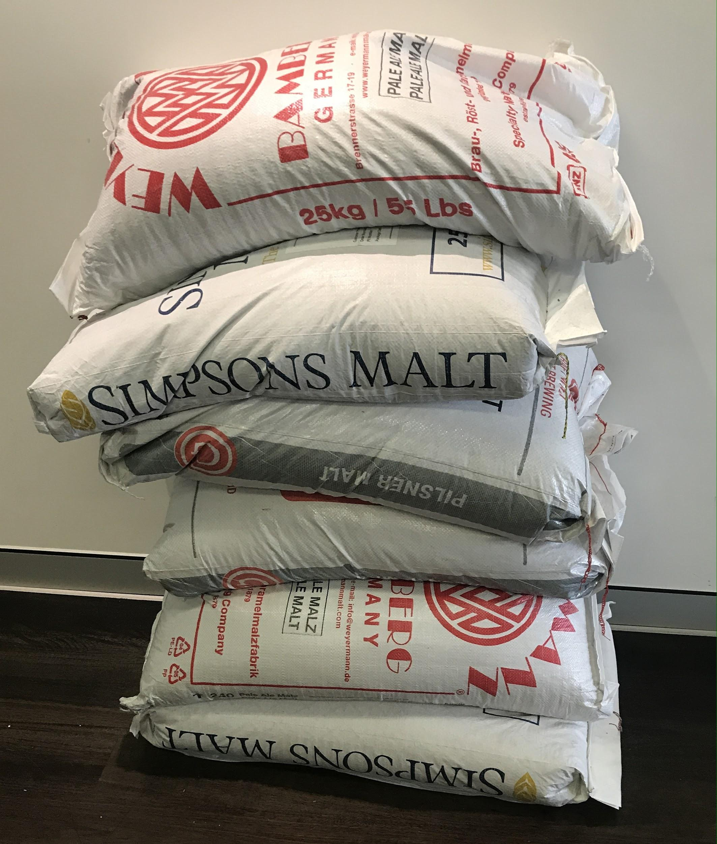
Challenge #1 - Finding some fresh Grain
Easy today but you do still need quite a lot!
A typical 50L Commercial keg ~ 12kg Consider that amount in colonial days farming effort!

Slide 17
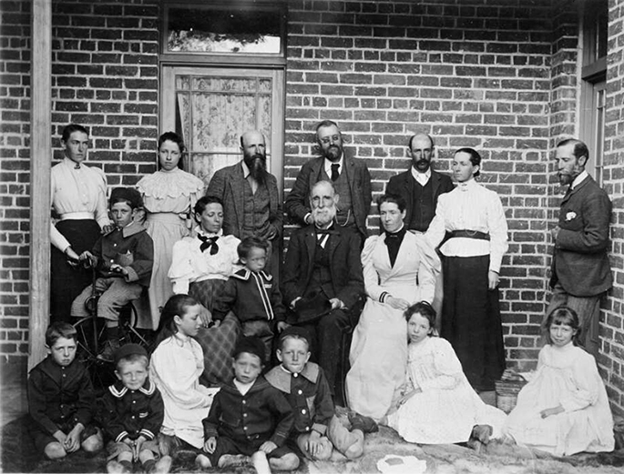
#1 - Grain providers in 1800s Australia
Many barley growers, including Squire (45 acres)
William Farrer was first to cross-breed barley in Australia
Making it hardier to disease (‘rust’)

Slide 18
#1 - Colonial grain - Varieties
Not a great deal of choice in colonial barley growing, most likely seeds would have come from England, Pioneer (the brewery in Orange actually grows their own today)
Mittagong, NSW was the first barley Maltings
Today we talk about base and speciality malts. Malts are roasted germinated grains

Slide 19
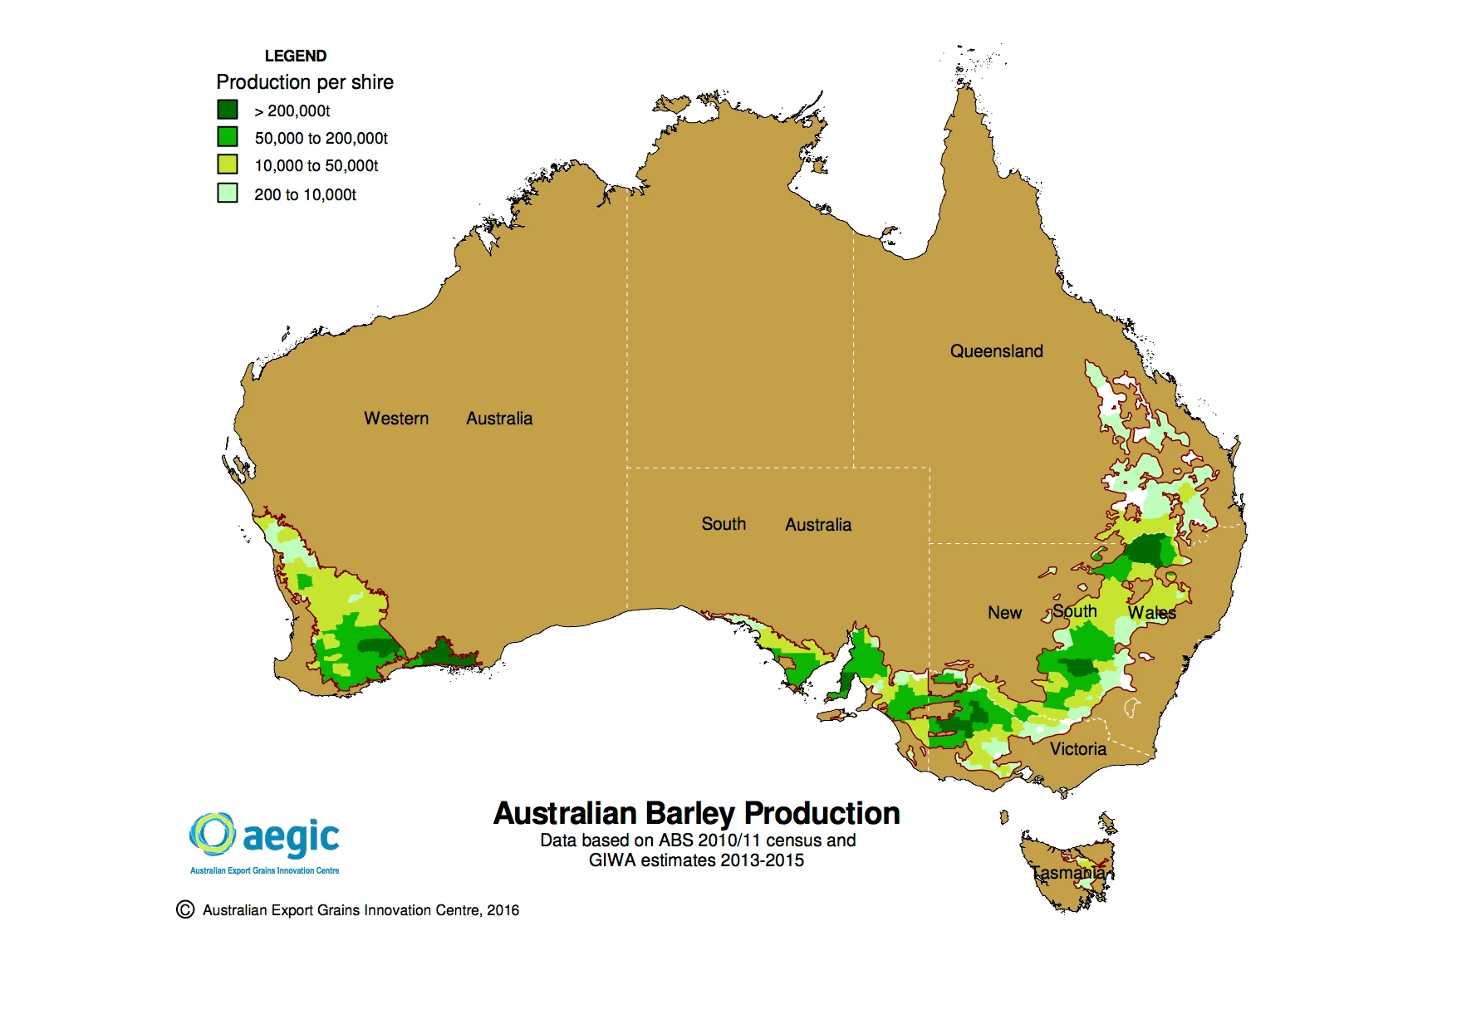
#1- ‘Base Malts’ produced in Australia today
Spartacus/LaTrobe/Bass/etc barley grown and malted/kilned within Australia - 900kt of malt from one million tonnes of barley prod per year! Pale (2 row) malt Pilsner malt Ale malt Vienna malt Munich malt
Coopers source own in SA
Lion
Heaps of malt comes from Tassie
Joe Whites
400kt (many hops grow here too)
Barrett and Burstons
Barrett and Burstons

Slide 20

#1 - ‘Specialty malt’ grown or imported in Oz
Same barley, but longer/hotter roasts for flavour Low diastatic Chocolate Carahel/pils/* Aciduated Crystal Patent Black … many more ...
Russia produces the most barley
1800kt Ukraine 940kt
Germany 1070kt France 1040kt
900kt - 200kt stays in Australia

Slide 21
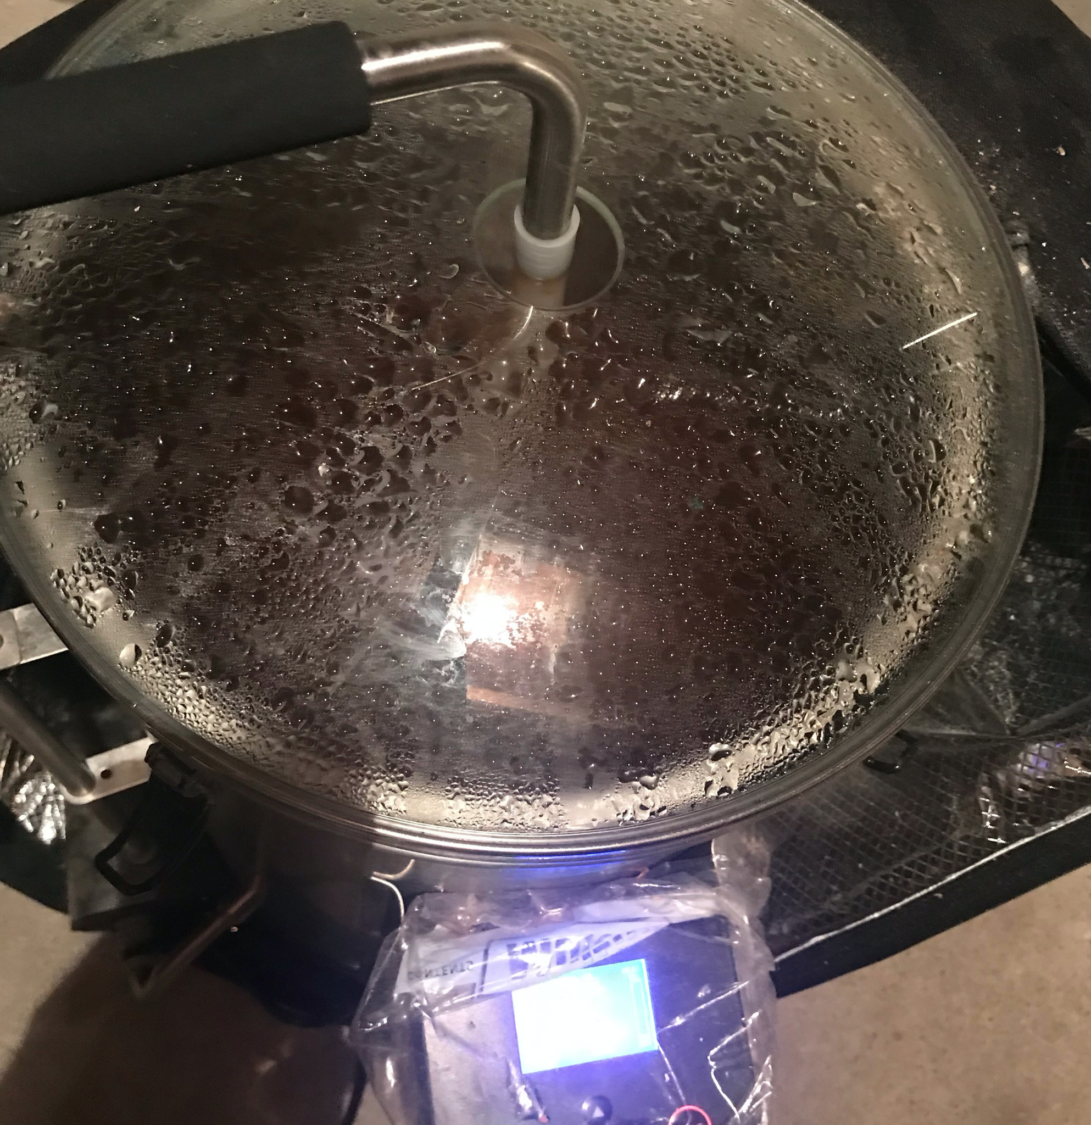
#2 - Mill/Crush the grain bill into hot water (liquor)
Mashing is wetting then holding crushed grain at various temperatures for enzymes to convert starches into sugars - different grains and beer styles vary in their mash steps
Ale malts typically 67°C for 1 hour
Many variations = flavours…
Getting it wrong affects efficiency = cost

Slide 22
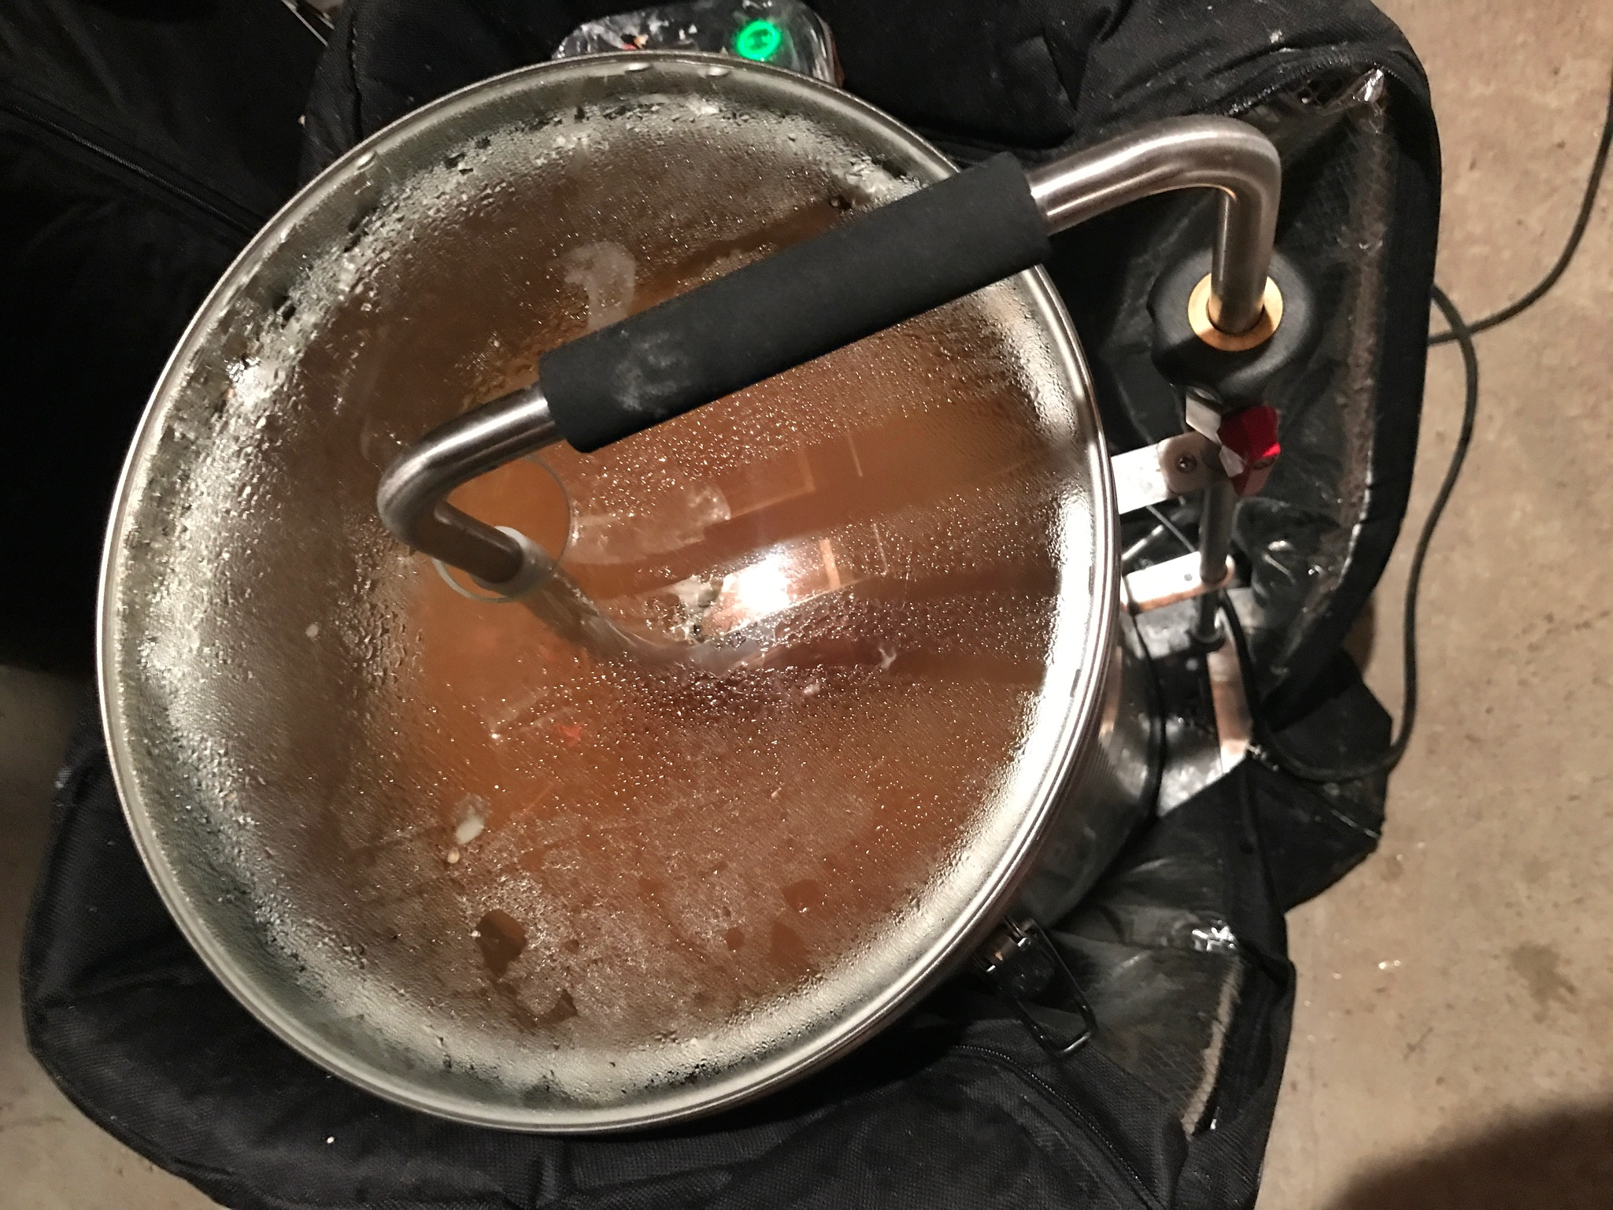
#2 - Mashing (enzymes convert starches sugars)
Pilsner malt 51°C for 30min then 67°C for 30min!
Most grains also need a ‘mash out’ at 75C to avoid diacetyl (= bad esters) being released
In 1790’s Sydney, how did they? brews were likely pretty inefficient
(this by the way is how it’s done today - this is computer controlled heating with a sensitive thermocouple feedback to electrical element - very precise step mash = best efficient)

Slide 23
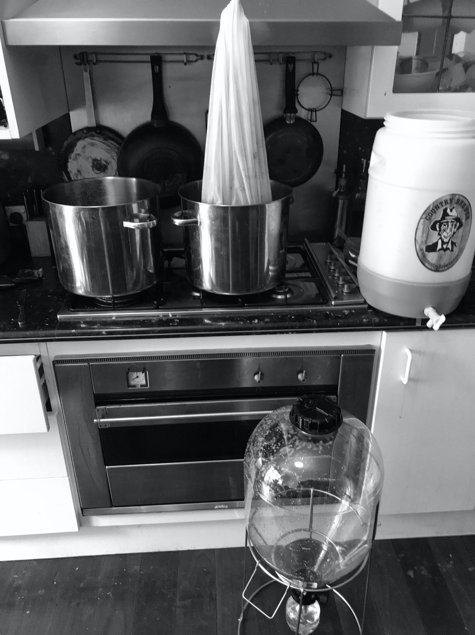
#3 - Lauter / Sparging the grain out of the wort
Removing the grain to leave only wort (said wert)
Large tanks used in larger breweries actually sift the grain husks away, on small scale you just make a tea bag
Then gently (very very gently) wash the grain through, at 75°C to about 115% liquor

Slide 24
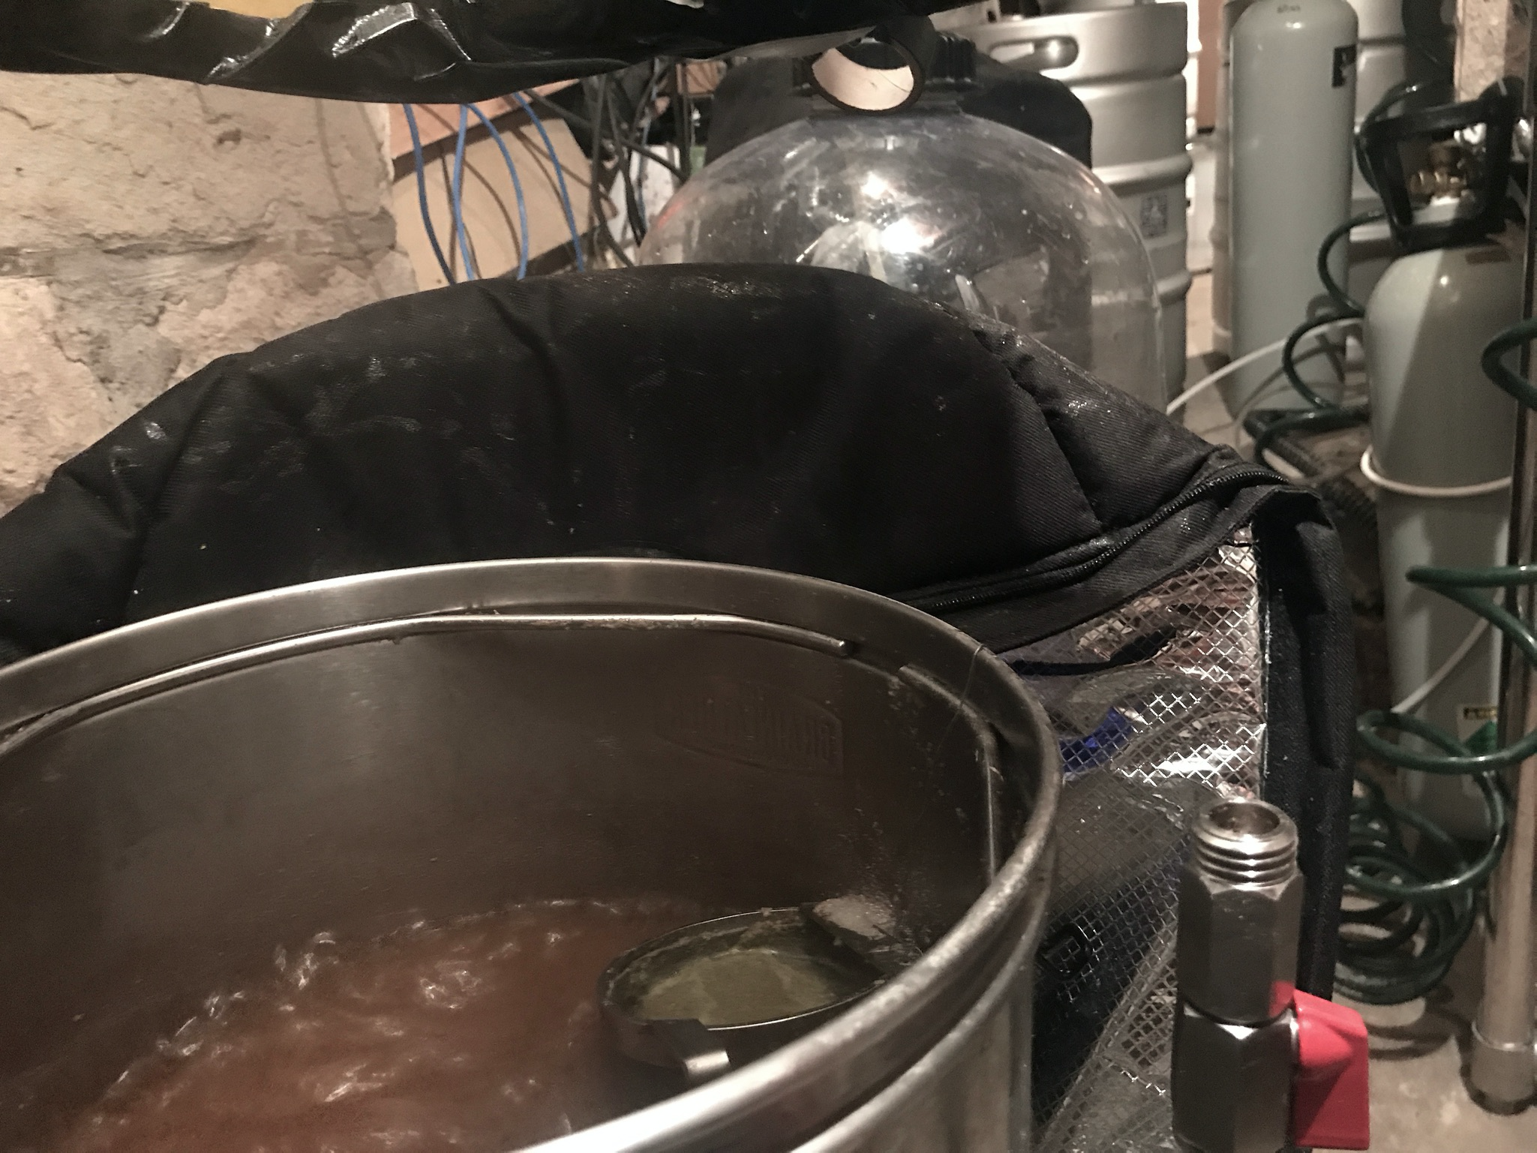
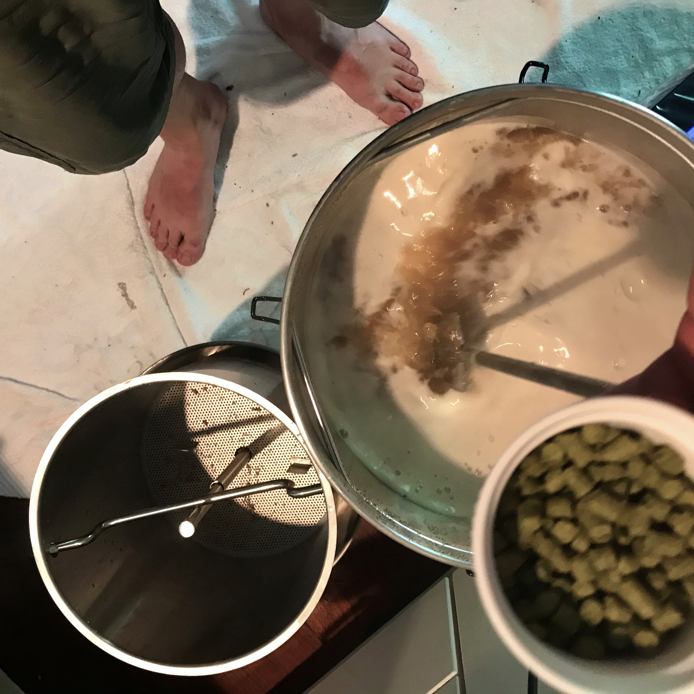
#4 - Boiling - easy enough in colonial days too
Literally hard boil at 100°C (no less) for an hour to 1½ hours (any volume - hence that extra 15% liquor)
Hops added in various stages Bittering hops in at the start + often in the middle boil
Aromatic hops go in at the end

Slide 25

#4 - Hop choices (then)
Beer without hops is sickly sweet - bittering hops from Kent oast houses came via HMS Daedalus
Hops were a bit of a cash crop back then - James Squire grew on 4 acres at Kissing Point
(East Kent) Goldings hop > 200 years cultivation
Unlikely to have (any) aromatic varieties around

Slide 26
#4 - Hop choices (today)
Varieties of hop, many are Aussie and NZ ones!
Bittering Hops Admiral, Agnus, Apollom, Banner, Bitter Gold, Bravo, Brewer’s Gold, Bullion, California, Cluster, Chelan, Comet, Dr Rudi, Eastern Gold, Eroica, Feux-Coeur, Galena, Galaxy, Green Bullet, Kitamidori, Magnum, Millennium, Newport, Outeniqua,Pacific Gem, Pacific Sunrise, Pilot, Pride of Ringwood, Rakau, Riwaka, Satus, Sticklebract, Sorachi Ace, Southern Brewer, Southern Star, Sovereign, Summit, Super Alpha, Super Pride, Styr Golding, Symphony, Tillicum, Toyomidori, Vic Secret, Warrior, Yakima Cluster, Zenith, Zeus
Aromatic Hops Ahil, Ahtanum, Amarillo, Amethyst, Aquila, Aramis, Astra, Atlas, Backa, Bianca, Blato, Blisk, Boadicea, BOR, Bramling, Canadian Redvine, Canterbury Whitebine, Cascade Cekin, Celeia, Cobb, Columbia, Crystal, Dana, Defender, Density, Dunav, Early Bird, Early Green, Early Prolific, Early Promise, East Kent Golding, Eastern Green, Eastwell Golding, Enigma, El Dorado, Ella, Elsaesser,Equinox, Feux-Coeur Francais, First Choice,Fuggle, Furano Ace, Gargoyle, Golden Star, Golding,Groene Bel,Hallertau, Hallertau,Helga,Hersbrucker,Red-Stem,Hüll Melon, Hort4337, Hort9909, Hybrid-2,Ivanhoe,Janus,Jester,Keyworth’s Early + Midseason, Kohatu, Landhopfen, Liberty, Lubelska, Lubelska-Pulawy, Lucan, Melba, Mandarina Bavaria, Mathon, Motueka,Mount Hood,Mount Rainier,Nadwislanska,Nelson Sauvignon Nordgaard,Olympic,Omega,Pacific Jade,Pacifica,Palisade,Petham Golding,Pocket Talisman,Precoce de Bourgogne,Premiant,Progress,Record,Red Earth,Riwaka,Saaz, Santiam,Saphir,Saxon,Serebrianka,Shinshuwase,Sladek,Sonnet,Spalt,Spalter, Summer, Sylva, Topaz, Wai-iti, Waimea, Willametta … (lots and lots of hop varieties basically)

Slide 27
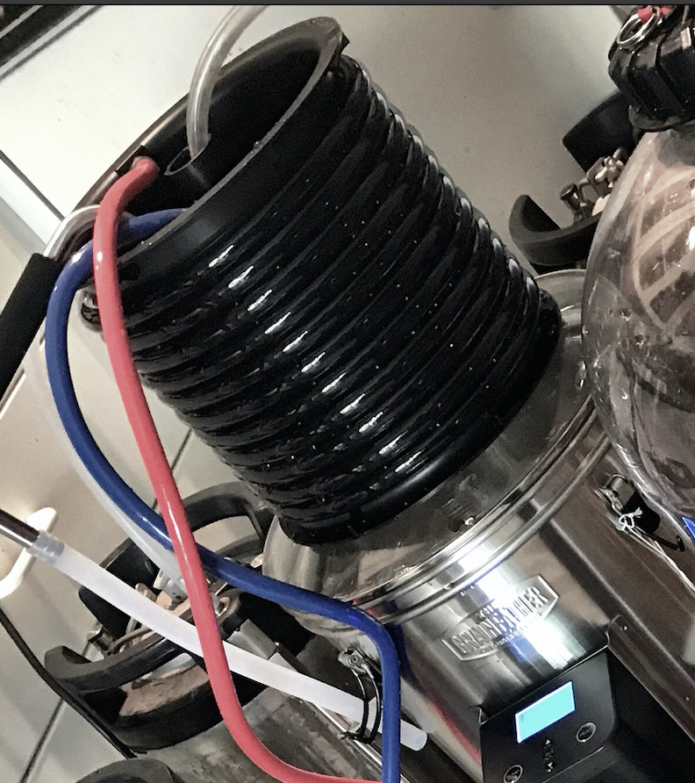
#5 - Cool/Oxygenate the boiled wort
Yeast is very fickle about temperature! Fermenting in Sydney would be tricky in depths of winter and heights of summer (but easy today)
Saison/Kveik yeast happy at 28C fast (5 days) - Ale yeasts at 18-22C is ok (takes 10 days) - Lager flat out dies outside of 8-12C needs precision diacetyl resting (takes 3 months) This is all modern yeasts - again, how did James Squire and John Boston manage in the 1790’s?!

Slide 28
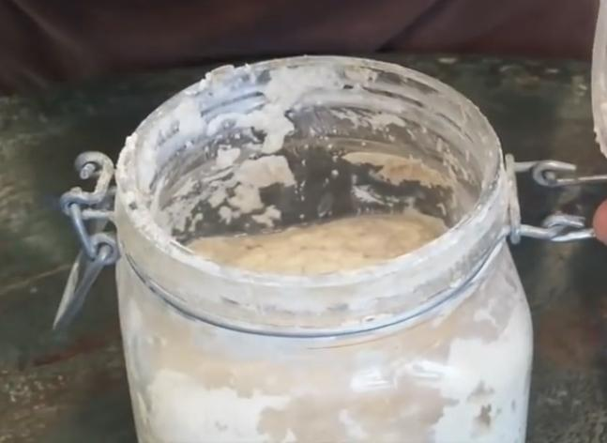
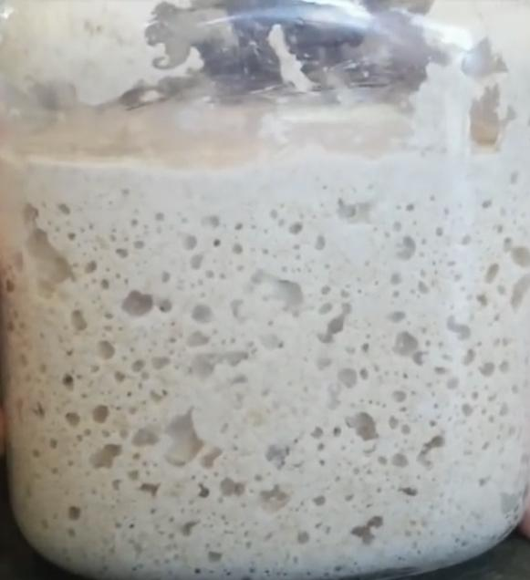
#5 - Yeast
Sugar -> Ethanol + CO₂
Colonial yeast
would have all been wild
Barmy top feeding yeast made from
flour/water, then left outside a week
Without refrigeration would have to be made fresh

Slide 29
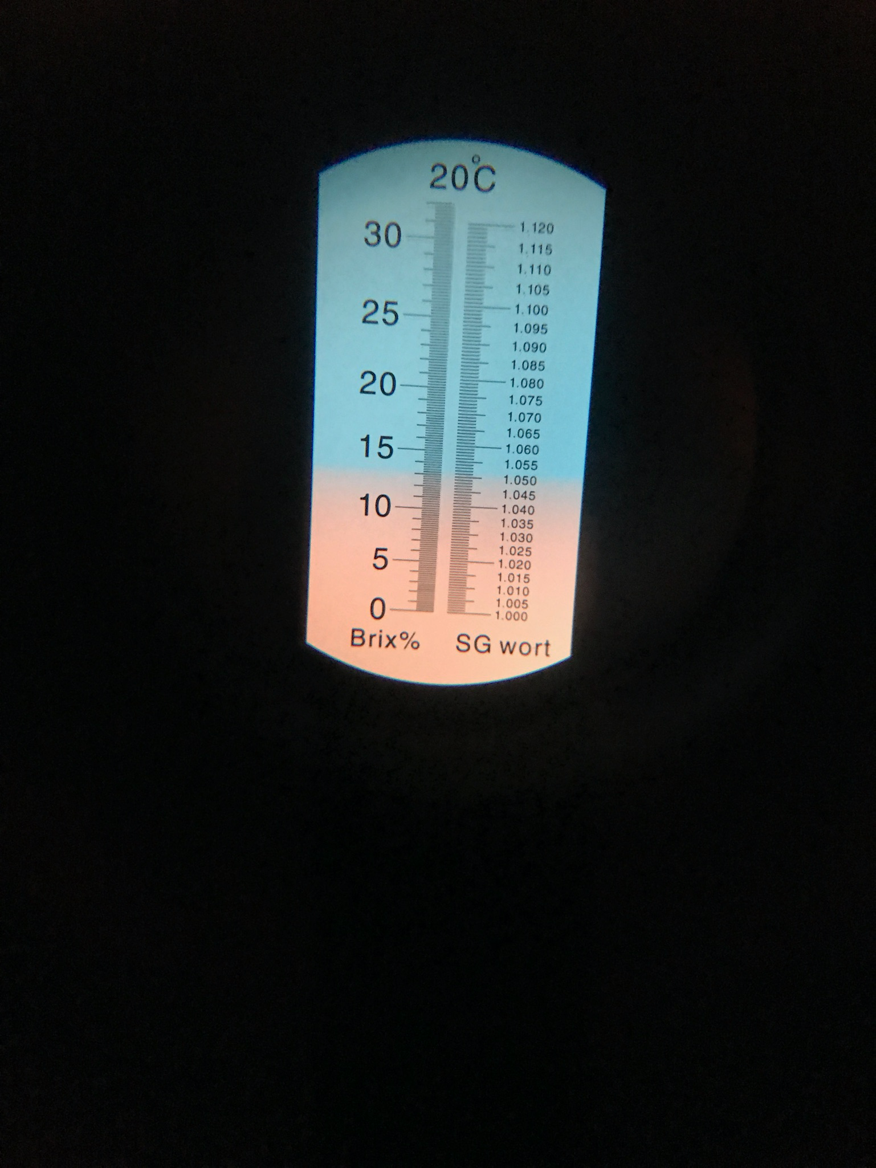
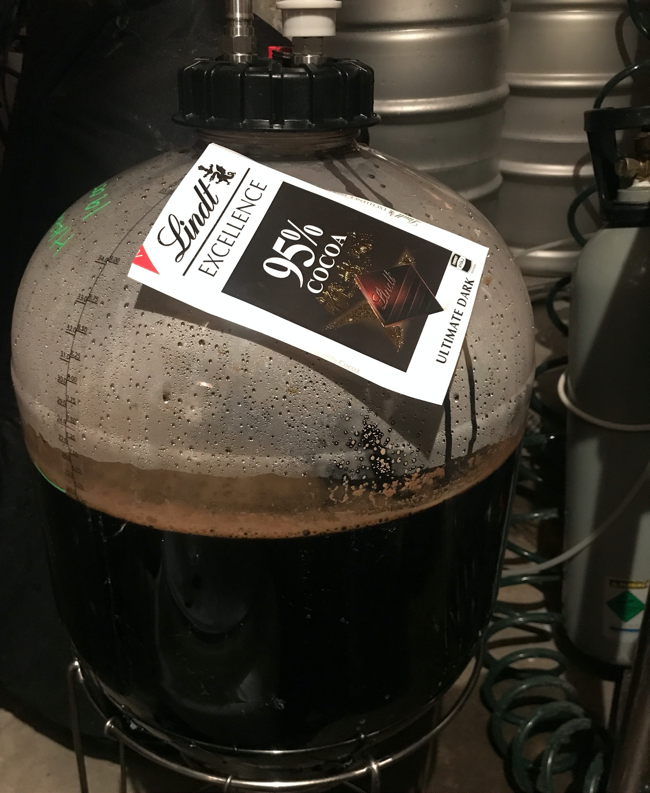
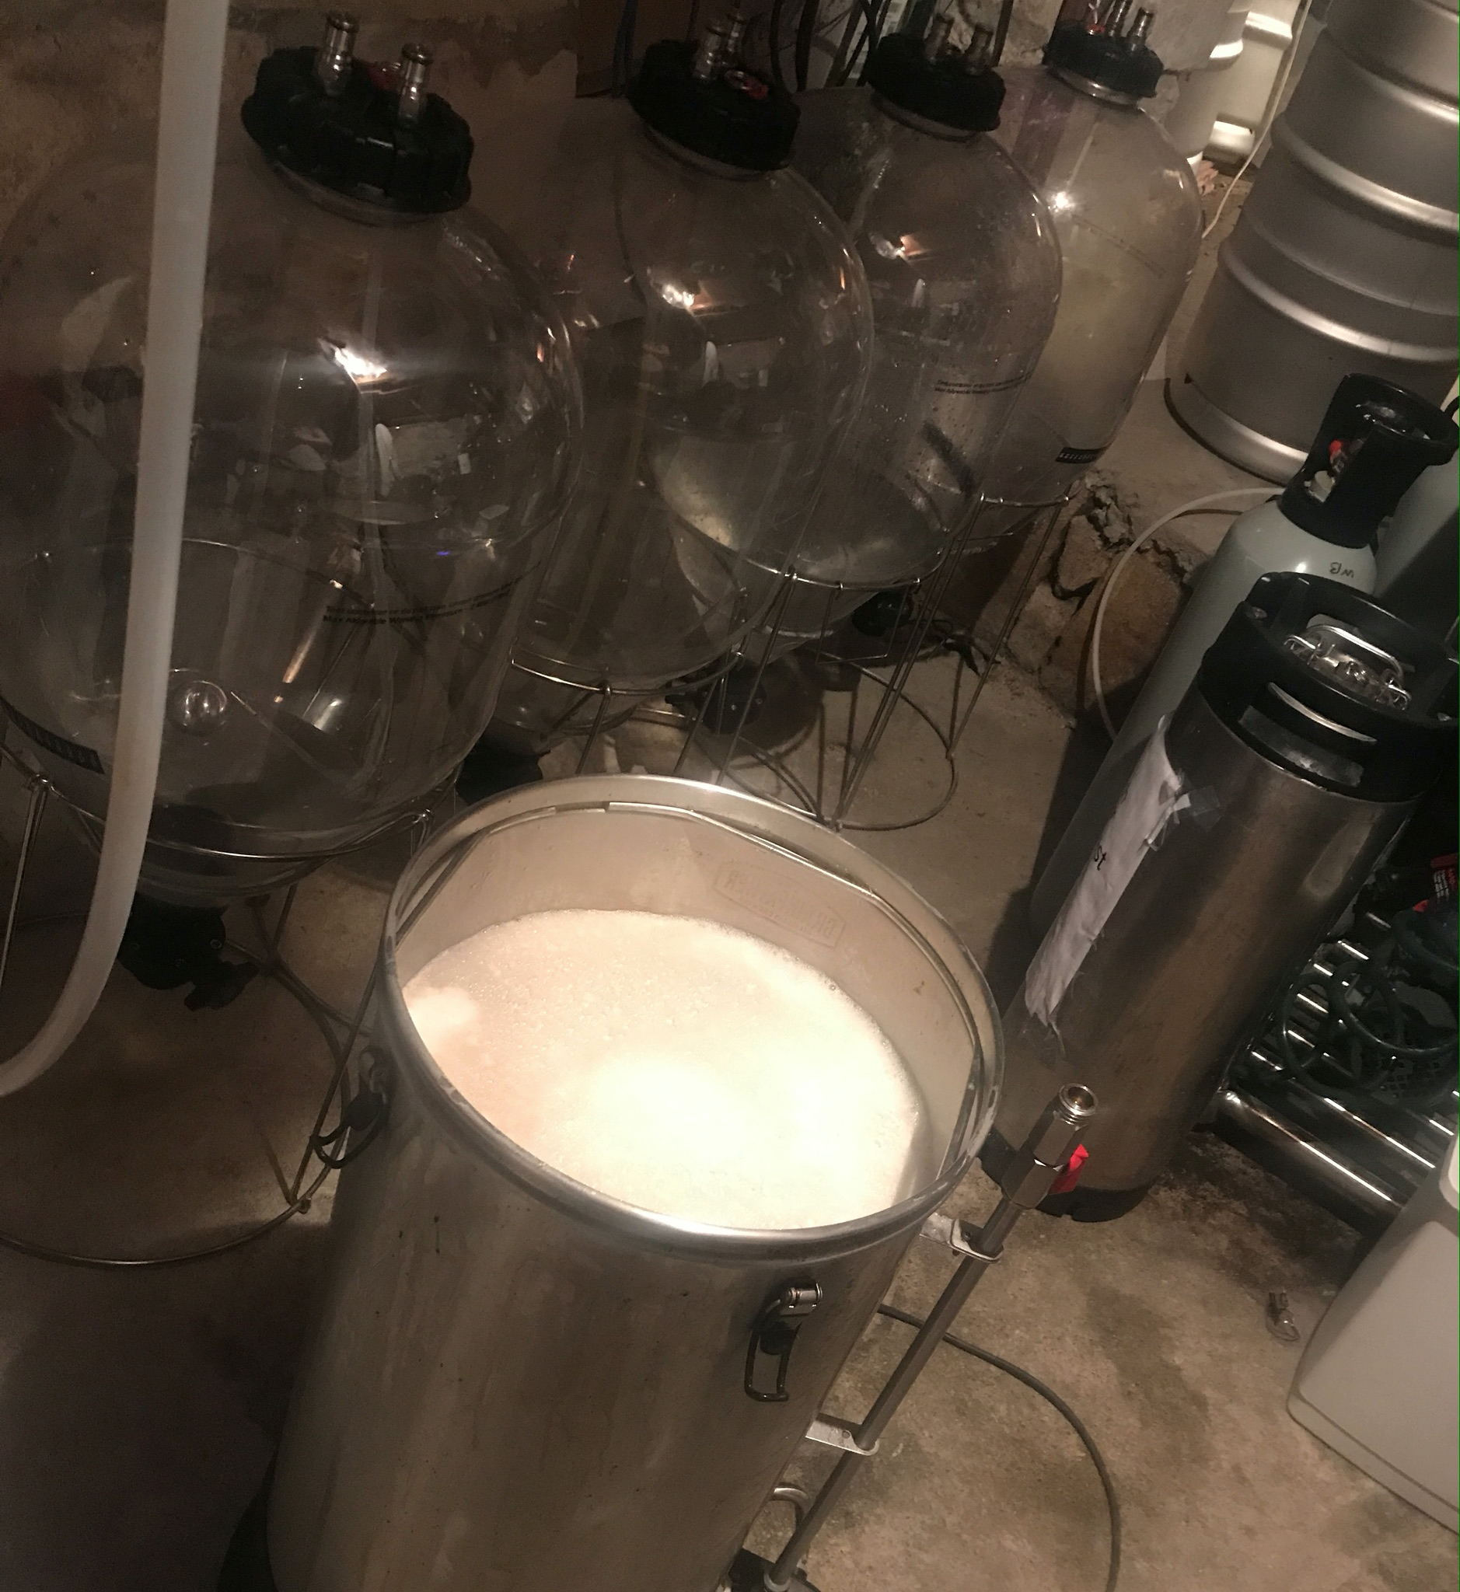
#5 - Fermentation
Time depends on the yeast
(e.g top or bottom feeding)
amount of active cells and
amount of sugars (food)
Original Gravity shown top right is 1.050 (light bends in a sugar solution, difference at end of ferment tells us the % alcohol made)

Slide 30
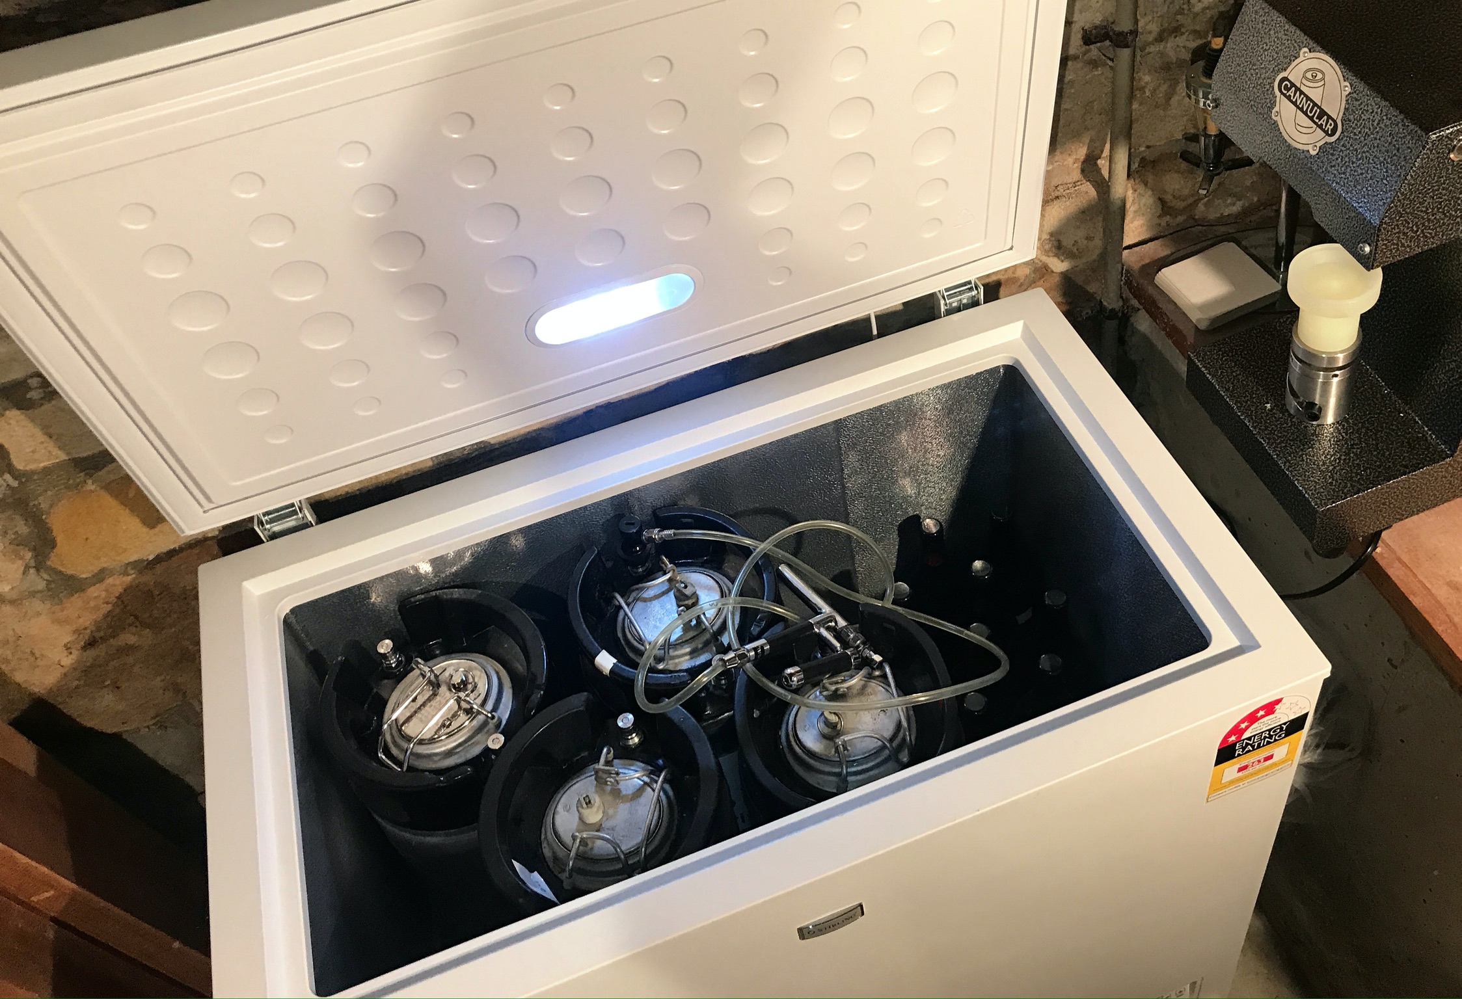
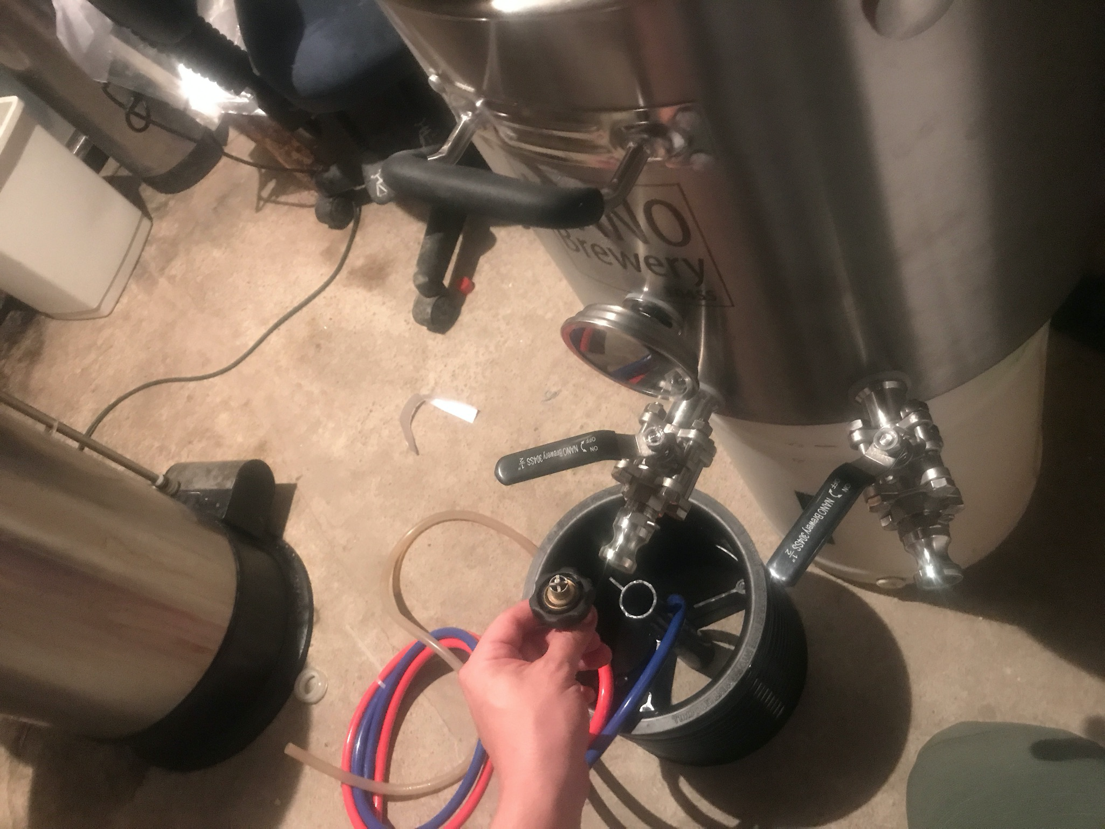
#6 - Racking and Waiting (depends on beer style)
Beers often take weeks to condition and become ‘brite’ ready to drink
Medieval ale, drank ‘fresh’ still fermenting
Oktoberfest Märzens traditionally are made way back in April!

Slide 31
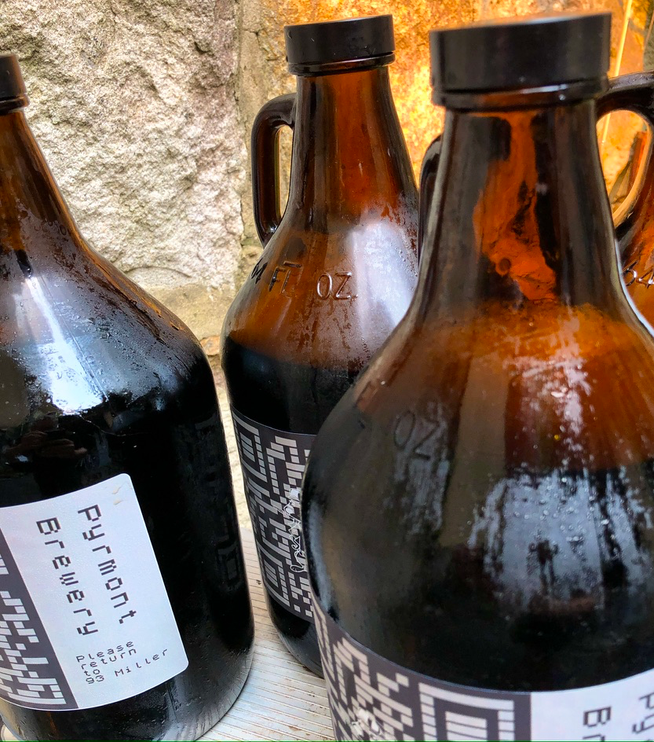
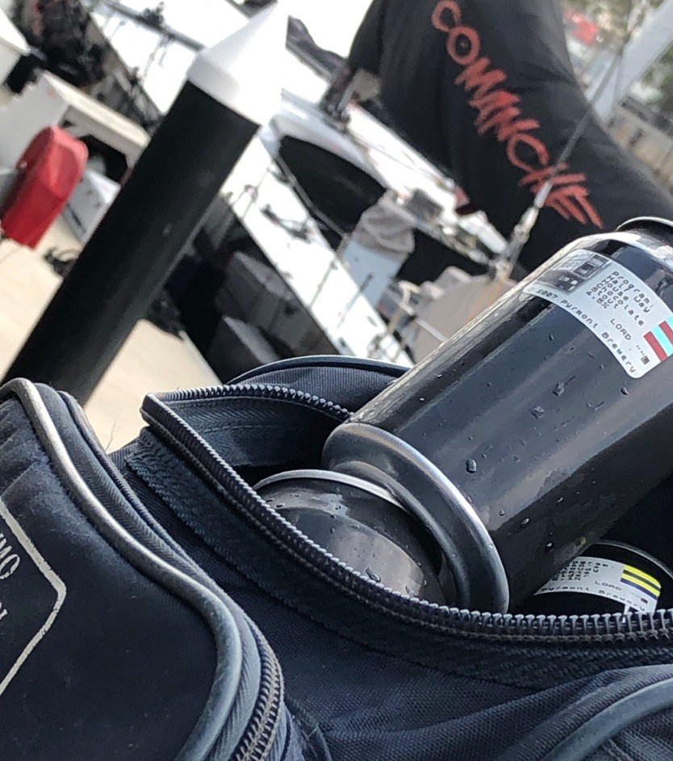
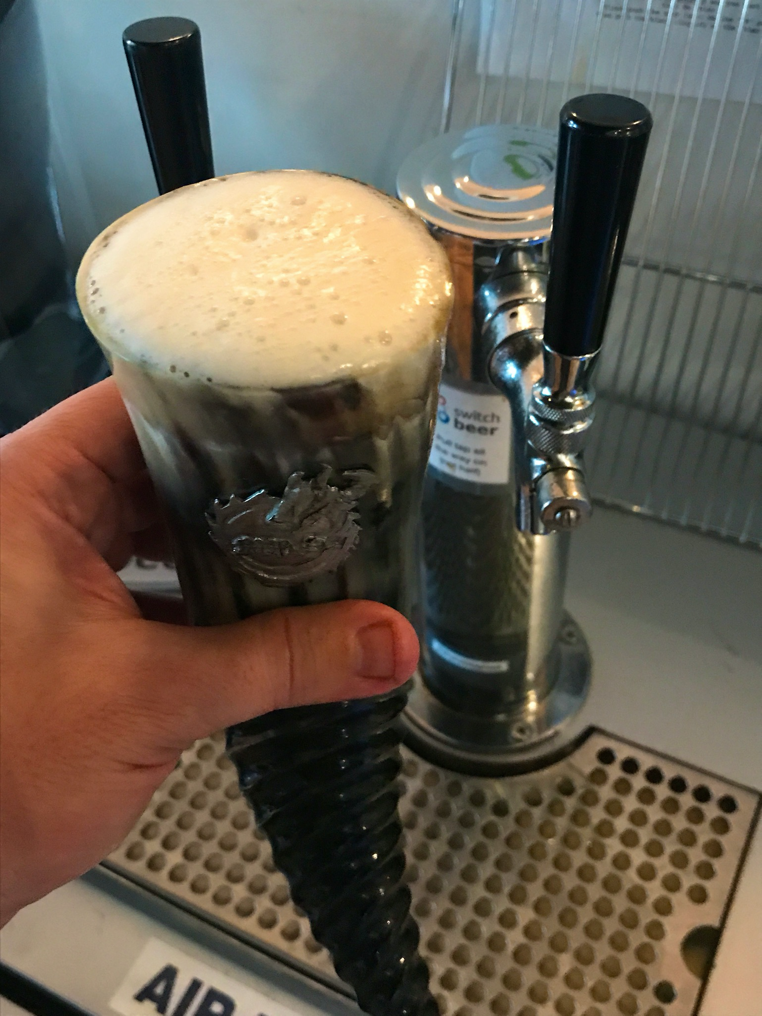
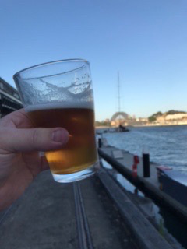
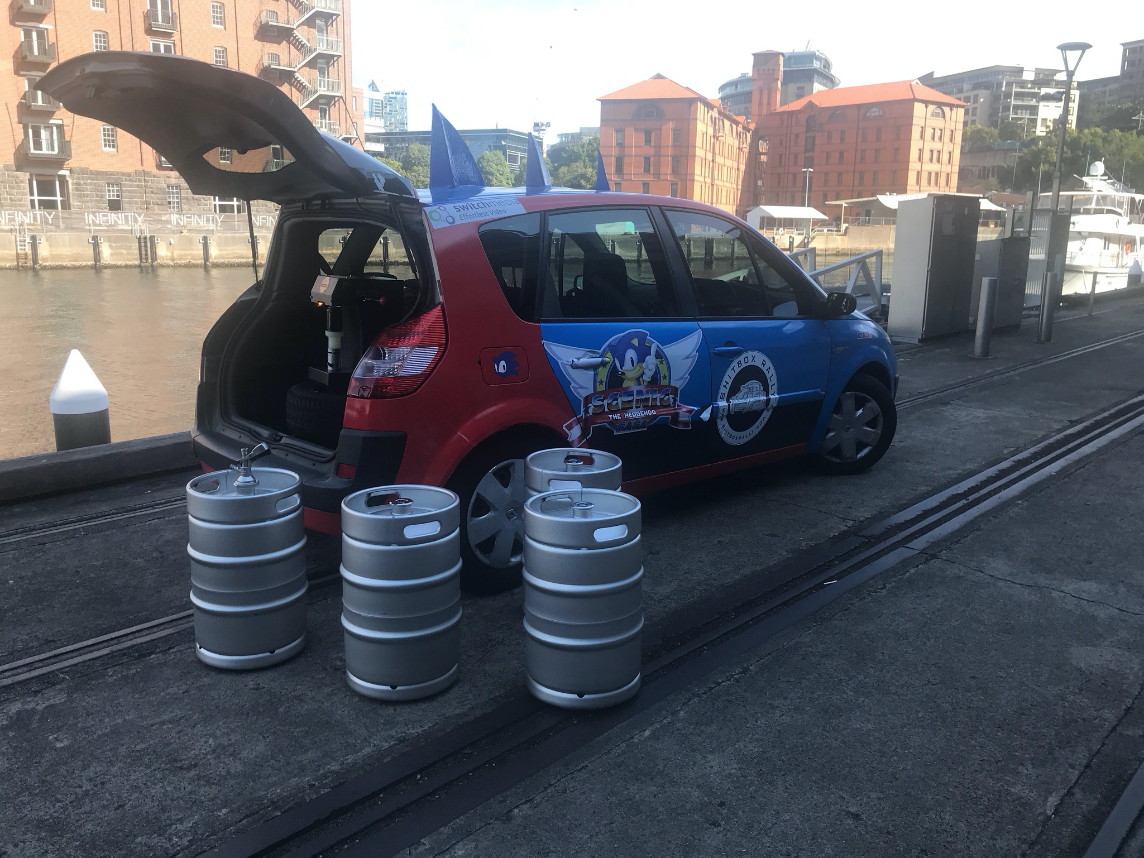
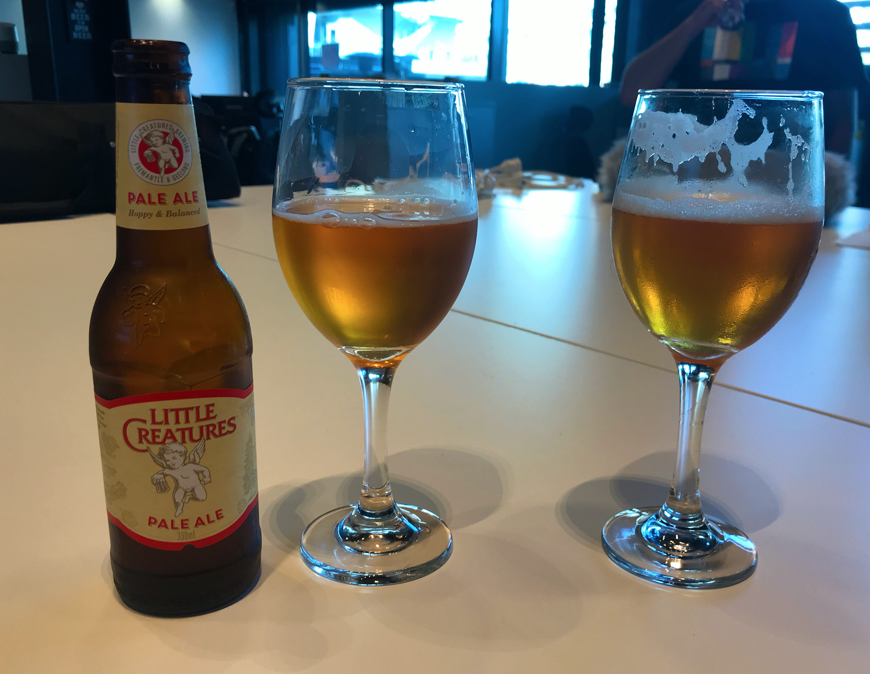
#6 - Resist drinking it all before you’ve
made more of it!
Pyrmont Brewery beers...
Hell Hole Helles
Half Way House Stout
Maybanke Dark Mild
Purgatory Pale
Quarry Quaffer

Slide 32
James’ brews couldn’t have been like modern beer
I’m intrigued as to what Squires beer did taste like, guessing most likely a warm flat English ale (Marris Otter like flavours from Pioneer pedigree grain)
None the less the quality was reportedly most excellent, and when James Squire died in 1822 he had the largest turn out at his Sydney funeral!

Slide 33

Enjoy!
PyrmontBrewery .com

Slide 34
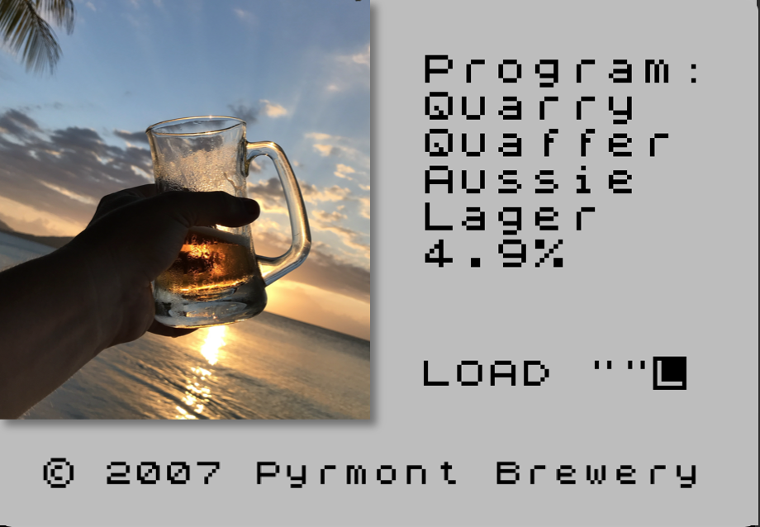
Enjoy!
PyrmontBrewery .com

Slide 35
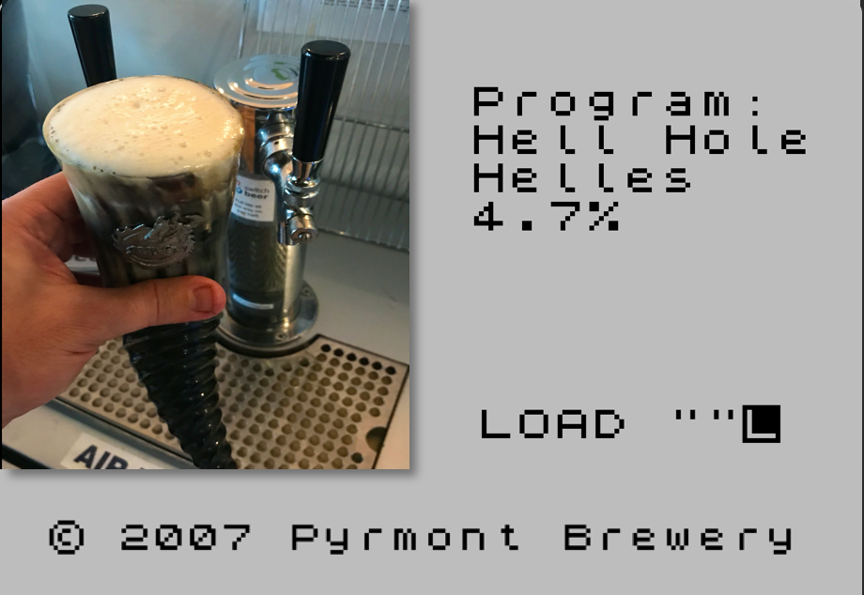
Enjoy!
PyrmontBrewery .com

Slide 36
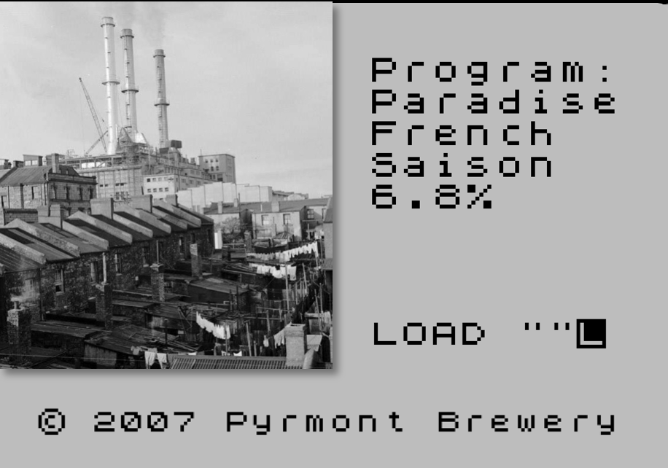
Enjoy!
PyrmontBrewery .com

Slide 37
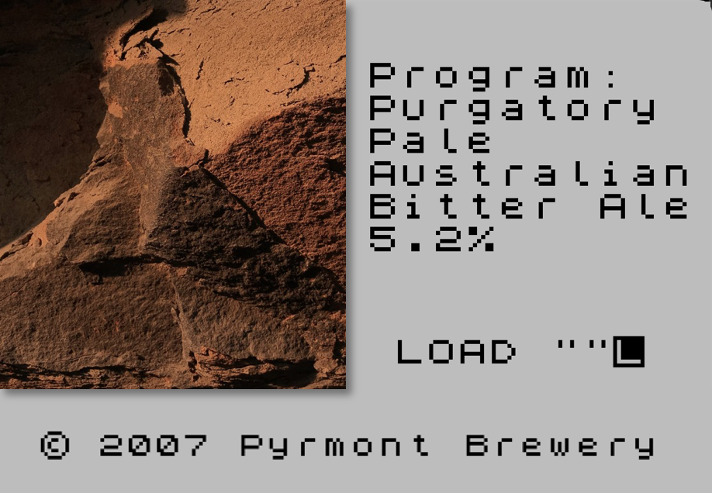
Enjoy!
PyrmontBrewery .com

Slide 38
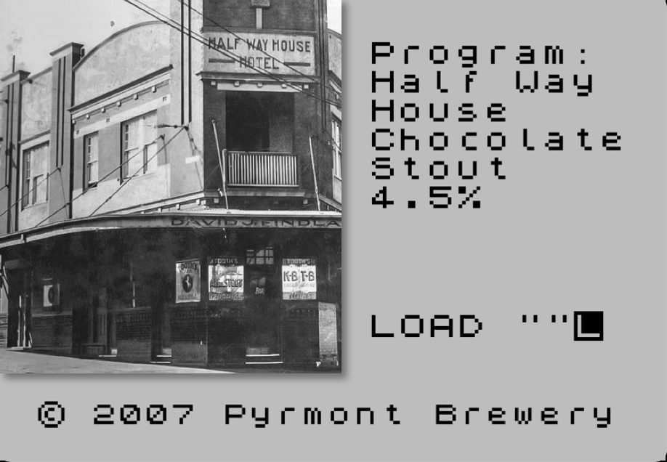
Enjoy!
PyrmontBrewery .com

Slide 39
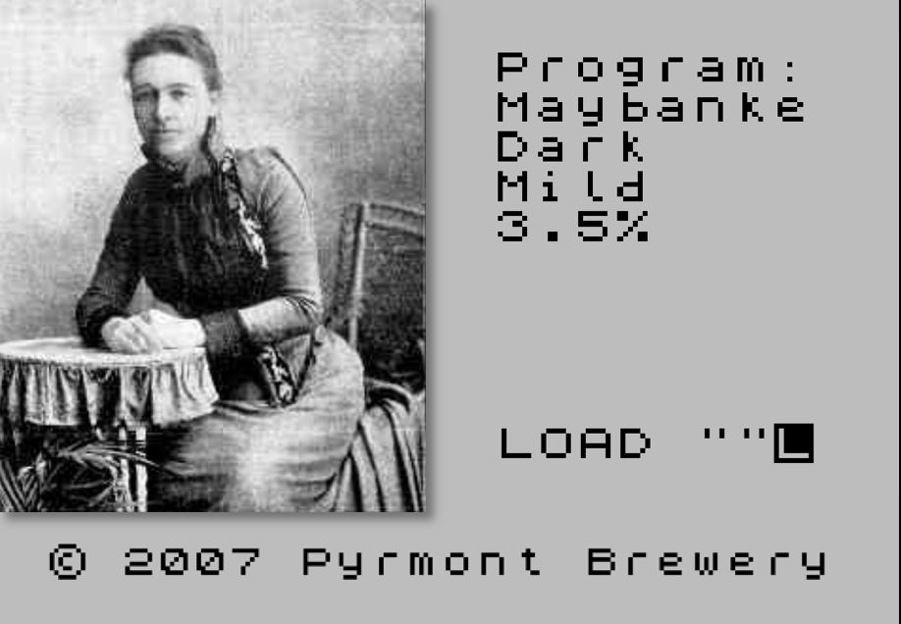
Enjoy!
PyrmontBrewery .com

Slide 40

Enjoy!
PyrmontBrewery .com

Slide 41
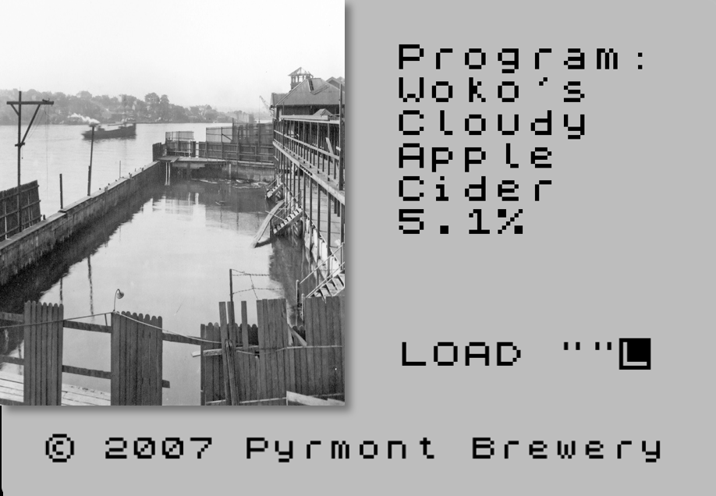
Enjoy!
PyrmontBrewery .com

Slide 42
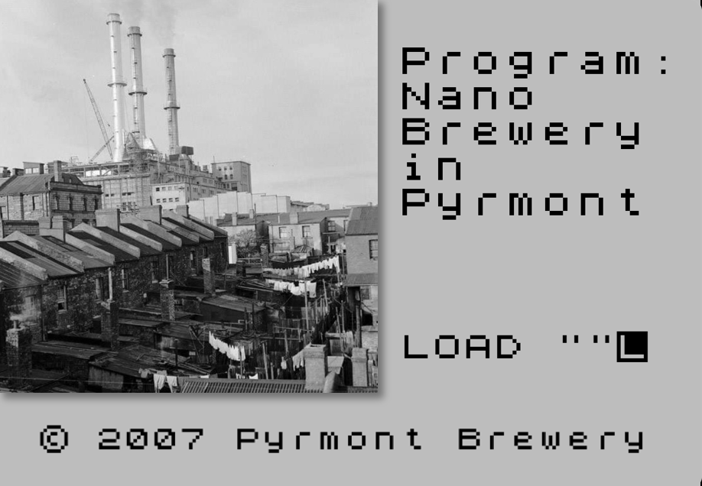
Enjoy!
PyrmontBrewery .com

